Slide 1
Wildfire Mitigation Program 2022
Public Briefing
April 28, 2022

Slide 2
Agenda
2022 Fire Season Weather Outlook
Wildfire Mitigation Plan
Public Safety Power Shutoff (PSPS)
Wildfire Mitigation Program Team
Looking Ahead

Slide 3

2022 Fire Season Weather Outlook
BONNEVILLE POWER ADMINISTRATION

Slide 4
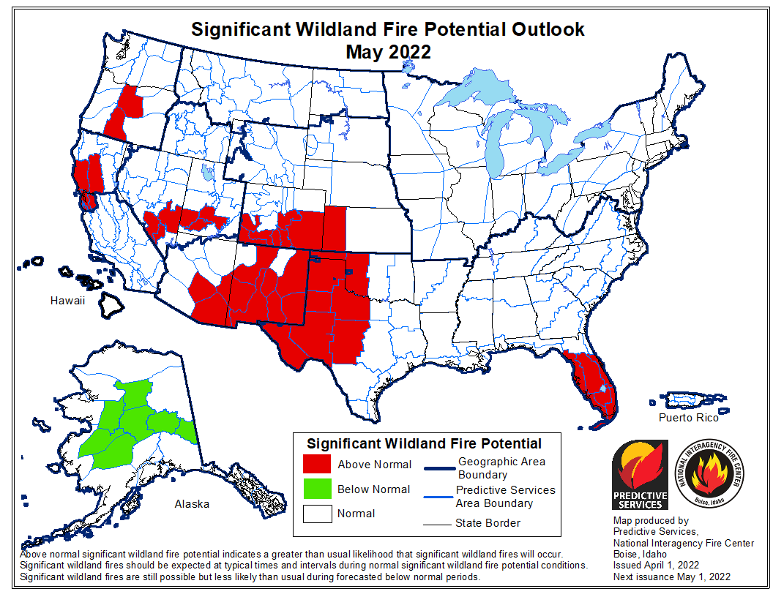
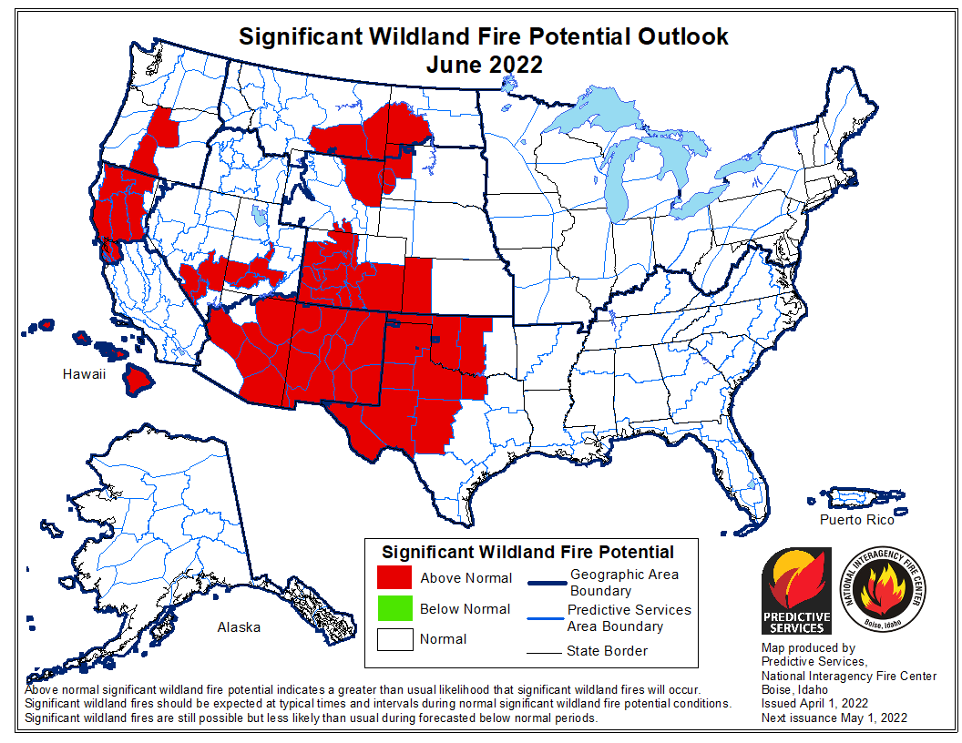
2022 Fire Season Weather Outlook
Better shape in the BPA Service Territory than last year. Current trends indicate a more normal fire season, but a hot/dry May or June could change the picture quickly.
One area of concern: East of the Oregon Cascades. However, recent rain and low elevation snow has helped.
NIFC will issue an updated outlook on May 1.

Slide 5
Wildfire Mitigation Plan
BONNEVILLE POWER ADMINISTRATION

Slide 6
“Light Touch” Wildfire Mitigation Plan update
Aligned with updated Strategic Asset Management Plan (SAMP)
Added 2021 lesson learned recommendations in the areas of communication, coordination, decision-making, planning, support, and technology
Applied Institute of Asset Management (IAM) methodology in bi-annual maturity assessment

Slide 7
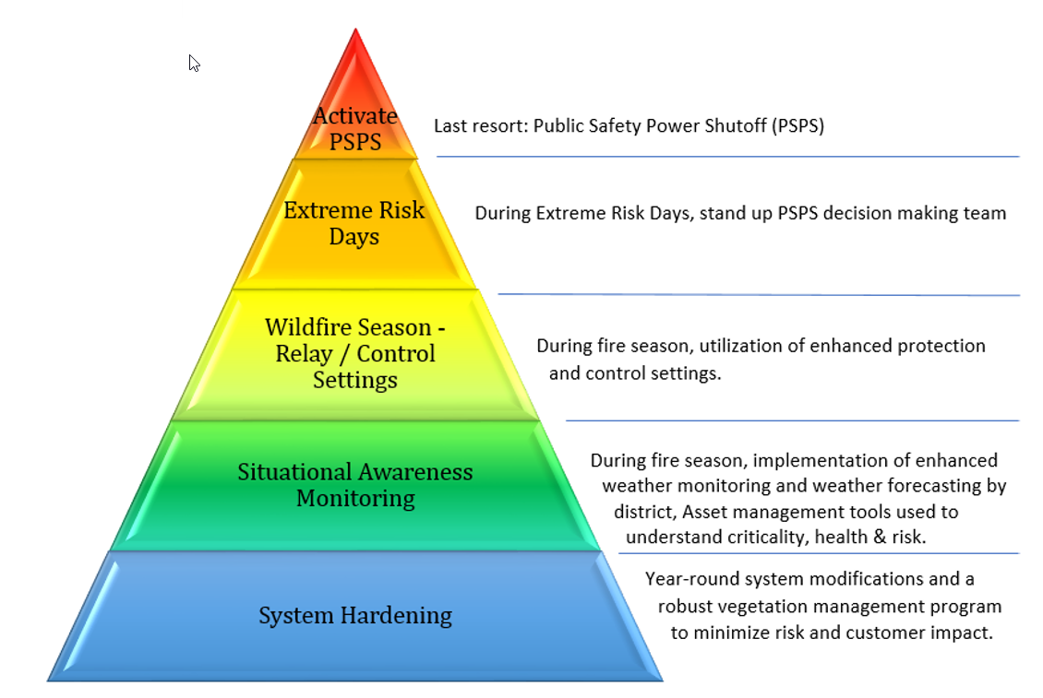
Wildfire Mitigation at BPA
PSPS is a “worst case” situation
PSPS is just one among many aspects of BPA’s overall wildfire mitigation efforts

Slide 8
Public Safety Power Shutoff (PSPS)
BONNEVILLE POWER ADMINISTRATION

Slide 9
BPA PSPS 2021
“PSPS Plan v1.0” for the 2021 fire season
  Proactively turning off power system equipment to remove potential ignition sources during extreme fire hazard weather events.
  De-energizations for active wildfires are not PSPS.
PSPS Team activations on 6/21 and 7/21
  6/21: PSPS Brasada-Harney #1 115 kV
  7/21: Weather conditions did not warrant a PSPS

Slide 10
PSPS 2021 Lessons
Issues from last year’s event
  First event confusion
  Short lead time (just a few hours)
  Operational communication happened significantly before non-operational communication
Improvements from last year’s event
  Earlier non-operational communication
  Meeting with affected utilities before (if time allows) and after the event
  Seeking information regarding utilities that aren’t directly affected by event but could become affected if certain other operational events occur simultaneously

Slide 11
PSPS 2022 Preparations
Currently there are fewer line segments on BPA’s PSPS list, but there are two caveats:
  Lines may be added “mid-season” as a result of the fire risk and local impact analyses PNNL is providing through April
  BPA retains the right to de-energize assets in response to emergent conditions, so just because a line segment is not on the 2022 PSPS list does not necessarily mean operational contingencies will not require proactive de-energization
Maturation of fuelscape and local impact analysis modeling, in partnership with Pacific Northwest National Lab (PNNL)

Slide 12
PSPS 2022 Preparations
BPA will conduct small meetings with utilities affected by equipment that becomes at an elevated risk as a result of the analysis to help them understand the expected switching and loads affected

Slide 13
Wildfire Mitigation Program Team
BONNEVILLE POWER ADMINISTRATION

Slide 14
Wildfire Mitigation Program Team
Cross-agency team meets regularly to identify, prioritize, and execute on a wide range of complementary maturation efforts
Julie Barton-Smith manages BPA’s Transmission Asset Management and Wildfire group

Slide 15
Looking Ahead
BONNEVILLE POWER ADMINISTRATION

Slide 16
Maturation
As part of BPA’s Wildfire Mitigation Plan, the cross-agency team continues to mature the agency’s approach to wildfire risks by:
  benchmarking with industry,
  participating in national and international organizations,
  continuing collaboration with federal and state agencies, and
  soliciting regional stakeholder input.

Slide 17
Automation & Standardization
Since mid-2021, as part of its Grid Modernization initiative, BPA has been working on a multi-year project to develop or procure a wildfire risk modeling software tool that can support both longer-term programmatic planning and real-time situation awareness.
As state earlier, BPA is also maturing its fuelscape and local impact analysis modeling, in partnership with Pacific Northwest National Lab (PNNL).

Slide 18
Questions
BONNEVILLE POWER ADMINISTRATION
For more information, contact your Account Executive or Constituent Account Executive

