Slide 1
TOP & TP CFR
Annual Customer Workshop
August 12, 2026

Slide 2
This session will be recorded for training and notes purposes

Slide 3













WELCOME

Slide 4
TOP AGENDA
  Welcome/Introductions
  Safety Moment
  Operation Coordination Sessions
  TOPIC V13
    Clarifications
  System Equipment Change Form
  TOPIC V14 – Urgent Update
    TOP asset participation criteria
  2027 TOP Cost Allocation
  Contract Refresh
  Questions | Break
4

Slide 5
Safety Moment:
Preventing Employee Burnout

Slide 6
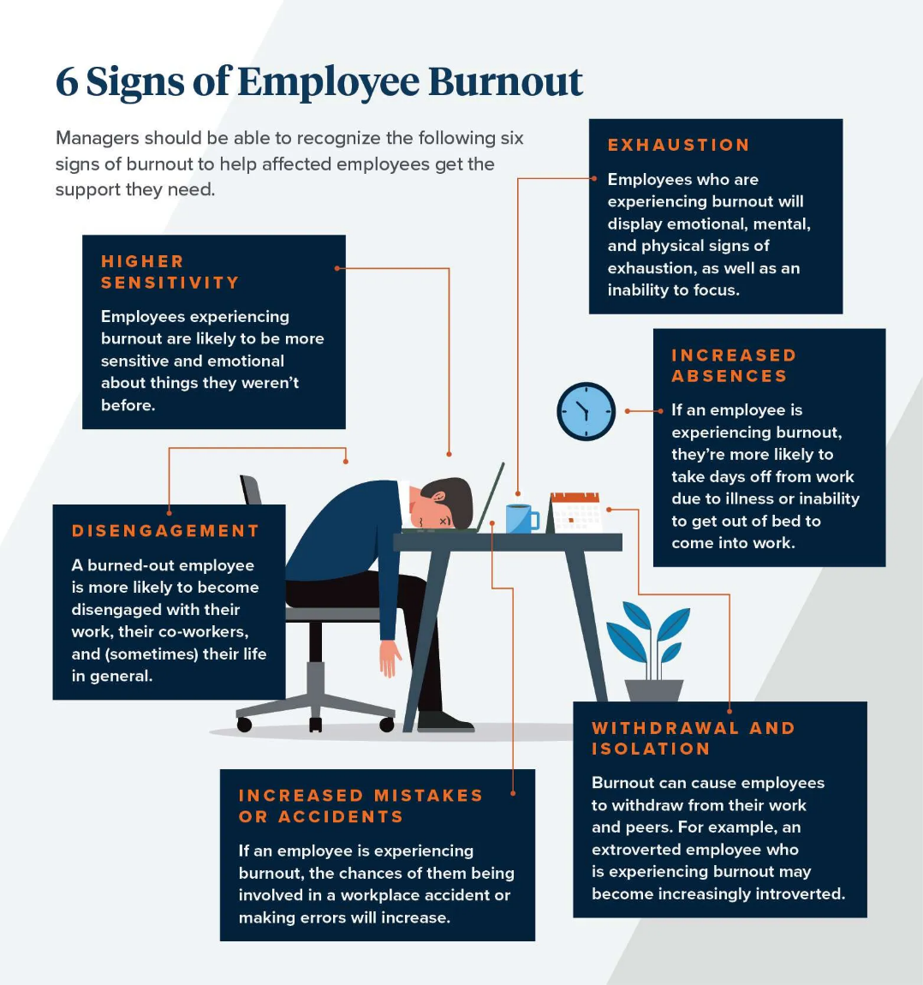
The Toll that Burnout can take on Employees:
  Exhaustion
  Increased Absences
  Withdrawal & Isolation
  Increased Mistakes or Accidents
  Disengagement
  Higher Sensitivity/Overly Emotional

Slide 7

Ways To Prevent Burnout
Here are some practical approaches to protect your team's well-being, while strengthening engagement and resilience:
  Promote Work-life Balance
  Provide Flexible Benefits & Choices
  Foster Open Communication
  Set Clear Expectations/Reduce Ambiguity
  Recognize & Reward Efforts
  Promote a Culture of Well-being
References:
How to Prevent Employee Burnout
Notes:
How to prevent employee burnout
Promote Work-life Balance
You can help prevent employee burnout by actively promoting work-life balance within your organization. While this sounds like a basic habit every employee has, some of them need a little bit of a nudge and a reminder every once in a while that deadlines aren’t as important as their personal life.
Actively discourage off-hour communication: This means refraining from sending non-urgent emails or messages during evenings, weekends, or holidays and respecting your team's personal time.
Give people time off during the day: Remind employees to take regular breaks throughout the workday to recharge and refocus. These breaks can include short walks, stretching, or engaging in brief relaxation techniques. Make vacation days a necessity: Lead by example and take your own vacation days to model the importance of taking time off for rest and rejuvenation.
Provide Flexible Benefits
A thoughtfully designed benefits strategy offers choices that address various dimensions of wellbeing:
Mental wellbeing support through diverse resources like therapy sessions, digital wellness platforms, and mindfulness tools helps employees navigate challenges before they escalate to burnout
Physical health initiatives including fitness allowances and preventive health services enable employees to maintain their physical resilience against stress
Learning and growth allocations for courses, professional certifications, industry events, and development coaching keep employees engaged through continued skill expansion
Flexible benefits not only demonstrate your commitment to employee well-being but also help attract and retain top talent. According to a 2023 SHRM survey, 95% of employers planned to maintain or increase their benefits offerings in 2025, with a focus on flexibility and customization.
Learn more about the impact of LSAs by reading Forma’s 2025 Lifestyle Spending Accounts Benchmark Report.
Foster open communication
Transparent dialogue serves as an early warning system for detecting burnout before it undermines employee wellbeing and organizational performance. Regular touchpoints with team members — both individually and collectively — help monitor workload balance, stress indicators, and overall engagement.
The workplace environment should make authentic feedback a norm rather than an exception. Multiple pathways for employees to express concerns, whether through scheduled one-on-one conversations, team forums, or confidential feedback mechanisms, create the psychological safety where genuine discussion can occur without fear of career consequences.
When team members share challenges, responding with attentiveness and acknowledgment rather than quick solutions or dismissal makes a significant difference. Partnering with them to develop practical interventions might include workload adjustments, deadline modifications, resource allocation, or temporary support structures..
Consistent messaging about available support resources across multiple channels reinforces your commitment to employee wellbeing. Regular highlights of mental health benefits, wellness programs, flexibility options, and organizational policies designed to protect sustainable work patterns demonstrate that preventing burnout is an organizational priority, not just an individual responsibility.
Set Clear Expectations
Setting clear expectations has become increasingly vital when preventing employee burnout. Ambiguity or frequent changes in roles, responsibilities, and performance objectives can rapidly lead to employee overwhelm and disengagement. Here’s how you can set expectations with more clarity.
Take the time to clearly define each team member's job description, outlining their primary duties, decision-making authority, and key performance indicators
Schedule regular check-ins with employees to discuss their workload, progress, and any challenges they may be facing. it's also important to consider individual strengths, skills, and development goals. Assign tasks that align with employees' abilities and interests whenever possible, as this can boost engagement and job satisfaction.
Recognize &Reward Efforts
Regular acknowledgment of employee contributions and achievements should be woven into your organizational practices. sometimes, a sincere expression of appreciation during team gatherings or individual conversations makes the most impact.
This could include monthly or quarterly awards for outstanding performance, peer-to-peer recognition systems, or spot bonuses for going above and beyond. Tailor rewards to individual preferences, such as public acknowledgment, professional development opportunities, or additional time off.
When employees feel that their contributions are recognized and rewarded, they are more likely to remain engaged, motivated, and committed to their work. Recognize and reward employees' growth and development as well. Provide opportunities for employees to take on new challenges, learn new skills, and advance their careers within your organization. This demonstrates your investment in their long-term success and helps prevent the stagnation that can lead to burnout.
Promote a Culture of Well-being
Prioritize employee well-being in your company's policies, communications, and leadership actions. This means going beyond offering a few wellness perks and instead embedding well-being into the fabric of your organization. Leadership plays a crucial role in modeling and promoting a culture of well-being. Encourage your executive team and managers to prioritize their own well-being and share their experiences with their teams. This could involve discussing their favorite stress-management techniques, sharing photos from their vacations, or openly taking breaks during the workday.
Celebrate healthy habits and work-life balance achievements across your organization. This could include featuring employee wellness success stories in your company newsletter, hosting virtual or in-person events focused on well-being, or offering incentives for participating in wellness challenges.
Create opportunities for employees to connect with one another and build supportive relationships. This could involve virtual coffee chats, peer mentoring programs, or employee resource groups focused on shared interests or experiences. Fostering a sense of community and belonging can help buffer against the isolation and disconnection that can contribute to burnout.

Slide 8
OPERATION COORDINATION SESSIONS
2026: Schedule EWEB Clark OKPUD (8/19) (11/19) Postponed due to weather conditions POPUD (8/20) Postponed due to weather conditions N. Wasco (8/27) LVE (9/1) Navy (TBD) | 2027: Scheduling in progress POPUD Cowlitz Klickitat UEC Whatcom Lewis Grays Harbor
8

Slide 9
OPERATION COORDINATION SESSIONS (2)
BPA continues to mature the TOP Services Operation Coordination Sessions (OCS)
We understand that the TOP program is not a ‘put on a shelf’ program and it requires continued active engagement from BPA and the Customer
Enhances continuity from ‘headquarters’ to the BPA district and Customers
Please continue to share ways to improve

Slide 10
TOPIC v13
Implementation update

Slide 11
SYSTEM EQUIPMENT CHANGE FORM
PROCESS CHANGES
SECF Process Changes
  Resubmission of the original SECF is required each time an energization date changes
    SECF Form
  Added Minor/Moderate Classification
  Modified form to align with TOPIC V13

Slide 12
TOP REIMBURSABLE PROJECT UPDATE
TOP team is processing all current in-flight projects to implement V13 changes
BPA has implemented the TOP Reimbursable contracts with customers with projects currently in-flight
  One exception that is currently under negotiation
“Box 13” clarification
  Box 13 on the reimbursable agreement is an estimate for the 5-year duration of the contract. That amount is not due at the time of signing.
  Each SECF has a deposit associated with that project
Deposit clarification
  Customers are required to submit the identified amount per project as a deposit for work to be performed
  At the conclusion of the project BPA will reconcile actuals and collect/refund remaining balance

Slide 13
TOPIC v14 Urgent Update

Slide 14
TOPIC V14 URGENT UPDATE
BPA will be issuing an urgent TOPIC update – V14 to address safety and reliability issues
NERC Rules of Procedure gap closure
BES Determinations – Section C TOPIC
TOP Services Participation Criteria

Slide 15
BES Asset Determination – Section C TOPIC
BPA will coordinate with participating Transmission Owners on BES Determinations to ensure a consistent application of the BES Criteria across the entirety of BPA’s TOP footprint
  "Application of ‘Core’ Definition and Inclusions" will be consistent with BPA’s application of BES criteria on BPA assets
BES Determinations
  In the event a TO chooses to apply exclusion criteria, the TO must provide the Regional Entity (WECC) approval per the ROP
    Applicable to assets energized from 2021 forward
  Implementation of the TOP Participation criteria

Slide 16
BES EXCLUSION APPLICATION
NERC Rules of Procedure Appendix 5A – 1.1 Purpose
An entity must request and obtain an Exclusion Exception pursuant to an Exception Request under this Exception Procedure before any Element that is included in the BES by application of the BES Definition shall be excluded from the BES. Likewise, an entity must request and obtain an Inclusion Exception pursuant to an Exception Request under this Exception Procedure before any Element that is excluded from the BES by application of the BES Definition shall be included in the BES.
Transmission Operator role:
BPA as the TOP must have full visibility of all assets in BPA’s TOP Footprint regardless of BES Status
BPA and the Regional Entity have identified a gap in BPA’s Transmission Operator Program in BPA’s lack of adherence to the NERC Rules of procedure Appendix 5
BPA and the requesting TO will coordinate on participating Transmission Owners BES asset determinations
Transmission Owner role:
TOP Services Participating Entities requesting an exclusion must coordinate with BPA prior to requesting the exclusion from the Regional Entity
  This will require a change in the SECF process to encompass ALL system changes meeting the BES Application of ‘Core’ Definition and Inclusions"

Slide 17
TOP SERVICES PARTICIPATION CRITERIA (1)
As a Transmission Operator, BPA must ensure the safe and reliable operation of all assets within its designated transmission footprint, regardless of ownership
BPA has seen a growing number of reliability and safety challenges in the TOP program
BPA has established additional draft TOP Participation Criteria to ensure safe and reliable operations
Meeting these requirements will be a contractual obligation under the TOP Services Contract and v14 TOPIC

Slide 18
TOP SERVICES PARTICIPATION CRITERIA (2)
BPA SMEs across transmission and system teams established the following criteria to ensure a safe and reliable operation of the BPA TOP Footprint.
BPA TOP Services Criteria for BES Determination:
Outage Transfer Distribution Factor (OTDF) impacts:
  Any facility that has a positive OTDF to a BES facility is deemed BES (see next slide for additional information)
The asset upon energization will be BES within 5-year Planning Horizon
Computational load per the current NERC CL draft definition
*BPA will update criteria #3 when the computational load definition is finalized

Slide 19
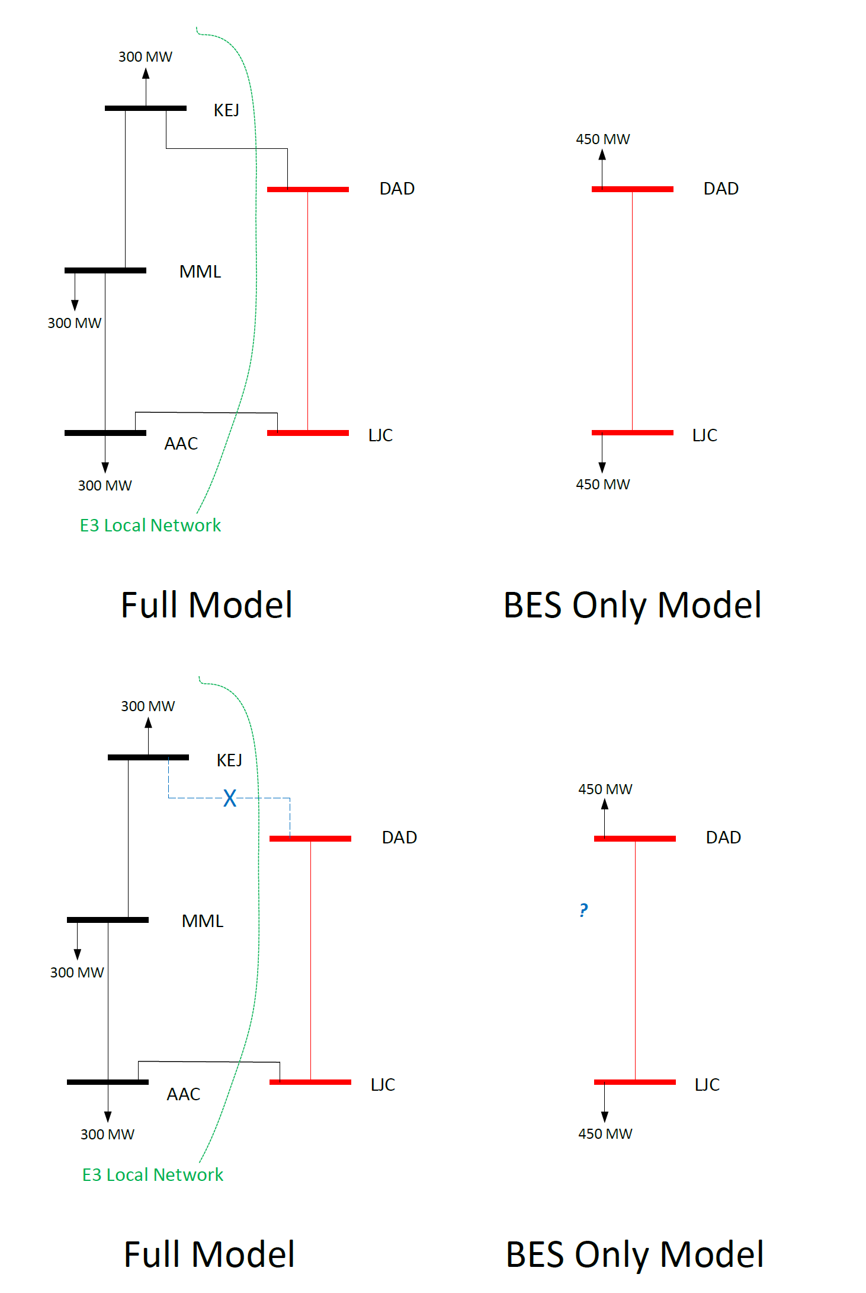
OUTAGE TRANSFER DISTRIBUTION FACTOR (OTDF)

Slide 20
TOPIC V14 Urgent update – next steps
8/21/2026: Post TOPIC V14 – Urgent Update
  Close NERC Rules of Procedure gap
  Continue to mature BPA – Transmission Owner BES asset determination process
Modified System Equipment Change form to align with TOP Services Participation Criteria
9/21/2026: Comments due on TOPIC V14
9/25/2026: TOPIC V14 effective

Slide 21
2027 TOP Operating Costs

Slide 22
2027 TOP COST ALLOCATION
Overall Operating Budget:
  2026 CY Operating Costs were: $1,278,888
  2027 Operating costs are: $1,579,200
    Travel Costs = $81,600
    6.5 FTE x $249,600 = $1,497,600 + $81,6000 = $1,579,200
  2026 vs 2027 delta increase = $300,312
Cost Distribution Adjusted:
  Base: 21% from 25%
  Load: $62.8/MW from $55.60/MW
  Bus: $2,704 from $2,103
  Line: $5,407 from $4,206

Slide 23
TOP CONTRACT REFRESH
Fall/Winter 2026 kicks off the 5-year TOP Customer contract renewal process
BPA is in progress of drafting the TOP Services contract template
  November 2026: BPA team will communicate the collection of customer comments collected along with necessary updates
  December 2026: BPA team will send out for comments
  January 2026: New TOP Services template will be finalized

Slide 24
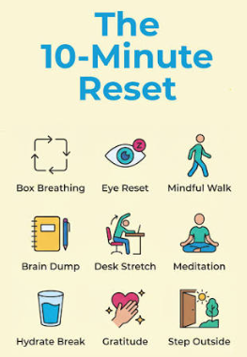
BREAK

Slide 25
Transmission Planner Coordinated Functional Registration
(TP CFR)

Slide 26
WELCOME TP CFR Customers

Slide 27
TP CFR MISSION STATEMENT
The BPA Transmission Planner Coordinated Functional Registration exists to facilitate the Transmission Planner function by ensuring timely and accurate data is collected and communicated through a collaborative and coordinated effort with our enrolled Transmission Owner Customers.

Slide 28
AGENDA
2027 TP CFR Cost Allocations
Compliance Packets
TPIP v8 Updates
Key Dates

Slide 29
2027 TP CFR COST ALLOCATIONS
Overall Operating Budget:
2026: $703,388
2027: $690,003
Cost Distribution Adjusted:
Base: 32%
Load: $64.50/MW
Bus: $4,642
Line: $9,285
  2027 TP CFR Service Cost Allocation Spreadsheet

Slide 30
COMPLIANCE PACKETS
Content of Compliance Packets
  2026 System Planning Summary Appendix
  Short Circuit Summary
  TPL-001 Data Request Submission
  Corrective Action Plan(s) (If Applicable)
New Distribution Method Box.com

Slide 31
TPIP v8 UPDATES – EXPECT WINTER 2026
TPL-008-1 Added
Update to Exhibit A BES Equipment to Align with Current Processes
Section 2 - Generator Owners
  MOD-027 Retired
  MOD-026-2 Updates
  Update to Appendix 1
    BPA MOD-025/026 Model Validation Process

Slide 32
KEY DATES
TP CFR Matrix Exhibit Annual Update
  April
TP CFR TPIP Update – Winter 2026
  TPL-008-1
  Exhibit A, BES Equipment Update to Align with Current Process
  Generator Owner Section Update
TP CFR TPIP Annual Update
  Moving Timeline
    Previous: June/July
    New: April/May
TPL-001-5 Data Request
  Moving Timeline
    Previous: April 1- May 1
    New: March 1 – April 1

Slide 33
QUESTIONS | COMMENTS
CSRP Supervisor
TOP TEAM
Megan Largo
Alesia Crisman
Kristin Judge
Debbie Dunn
Angela Rider
CFR TEAM
Alesia Crisman
Debbie Dunn
Angela Rider
Lorissa Cardoza

