Slide 1
TOP & TP CFR Annual Customer Workshop
August 28, 2025

Slide 2













WELCOME
2
2

Slide 3
TOP AGENDA
Welcome/Introductions
Safety Moment
Operation Coordination Sessions
TOPIC V12 Review
TOP Key Dates
ASR/ADE
FRR/SFRR
System Equipment Change Form
2026 TOP Cost Allocation
Questions | Break
3
3

Slide 4

SAFETY STARTS WITH YOU
4
4

Slide 5
OPERATION COORDINATION SESSIONS
2025:
Cowlitz
Klickitat
Umatilla
Whatcom
Lewis (10/28)
Grays Harbor (10/29)
2026: Target Month
Navy (Feb)
Lower Valley (April)
N.Wasco (June)
Okanogan (Aug)
Pend Oreille (Oct)
EWEB (Nov)
Clark (Dec)
5
5

Slide 6
TOPIC v12 UPCOMING CHANGES
Outage Coordination:
General Responsibilities
Appendix 2 Contacts
TADs Reporting:
Providing more clarity on process
Emergency Operations (EOP-011):
New section
System Equipment Change Process:
Broke out into sections for easier reference
Refreshing form to better align with BPA’s data flow
Cost Allocation:
New process
Customer Coordination Sessions:
Additional meetings
Failure to Comply:
Violation timing
6
6

Slide 7
TOP KEY DATES
January
New Billing Allocation Effective
Section 5c Compliance Validation
March
Section 4c TOP Services Letter
August
Customer Workshop
2026 Billing Allocation tip out
TOPIC V12 update tip out
September
TOPIC V12 open Customer review period
October
Annual TOP Billing Send outs
TOPIC V12 Customer review period closes
Customer Equipment & Billing validations
November
TOPIC V12 final
TOP External Site
7
7

Slide 8
2026 ANNUAL SYSTEM REVIEW LETTER TIMELINE
Mid-January
CSRP shares draft (.doc version)
Feedback/Question period
February
CSRP prepares final version (pdf)
March-April
Finalized
8
8

Slide 9
2025 ANNUAL DATA EXCHANGE
Customer | Send Date | Requested Due Date
Clark Public Utilities | 7/9/2025 | Received
Cowlitz County PUD No. 1 | 7/9/2025 | Received
Eugene Water & Electric Board | 10/2/2025 | 11/2/2025
Grays Harbor County PUD | 10/2/2025 | 11/2/2025
Klickitat County PUD | 8/4/2025 | 9/5/2025
Public Utility District #1 of Lewis County | 10/2/2025 | 11/2/2025
Lower Valley Energy | 10/2/2025 | 11/2/2025
Northern Wasco County Peoples Utility District | 9/2/2025 | 10/2/2025
Public Utility District No. 1 of Okanogan County | 10/2/2025 | 11/2/2025
Pend Oreille County PUD No. 1 | 9/2/2025 | 10/2/2025
Umatilla Electric Cooperative | 11/3/2025 | 12/3/2025
US Navy, Naval Base Kitsap | 10/2/2025 | 11/2/2025
Public Utility District No. 1 of Whatcom County | 10/2/2025 | 11/2/2025
9
9

Slide 10
FACILITY RATINGS
Updated Facility Ratings Report (FRR) and Seasonal Ratings Reports (SFRR) are published monthly
Facility Ratings notification process
Changes to limiting and second most limiting ratings are communicated via email when reports are published
Facilities list
Notification list
BPA is now operating to Version 9 Methodology! Some updates include:
Added fall season
-40C to +40C temperature range in 5-degree increments

Slide 11
SYSTEM EQUIPMENT CHANGE FORM
TOP team is beginning a process to analyze and then refresh the System Equipment Change Form to align with BPA’s data flow and associated processes. Items under consideration include but not limited to:
What is the purpose of the System Equipment Change Form
What is the criteria for submitting a new System Equipment Change Form
What if the 235-day rule cannot be met
What level of supporting data is BPA looking for
If the equipment ratings change does the 235-day rule start over
How is the System Equipment Change Form reviewed once it is received
11
11

Slide 12
TOP 2026 COST ALLOCATION
Overall Operating Budget:
2025: $983k
2026: $1.279 Million
Cost Distribution Adjusted:
Base: 25% from 32%
Load: $55.60/MW from $43.60/MW
Bus: $2,103 from $2,841
Line: $4,206 from $1,497
2026 TOP Service Cost Allocation Spreadsheet

Slide 13
TOP 2026 COST ALLOCATION
For the 2026 TOP Operating year it was determined that BPA’s FTE cost assumption needed to be aligned with BPA standards
BPA has a standard FTE calculation with overheads that the TOP Services Program will be using going forward from 2026
Each year the TOP team will obtain the current BPA standard FTE cost calculation to set the upcoming years operating budget
For FY25 a salaried employee is $122.97 /hour with overheads = $255,777.60
2025 CY Operating Costs were: $983,000
2026 Operating costs are:
5 FTE x $255,777.60 = $1,278,888
BPA adjusted the FTE costs to include overheads resulting in a 30.01% increase for 2026
The adjustments for the previous year will reflect FTE rate with overheads

Slide 14

QUESTIONS | COMMENTS

Slide 15
TP CFR AGENDA
Mission Statement
2026 TP CFR Cost Allocation
Compliance Packets
TPL-008-1
TPIP Review
TP CFR Key Dates
Questions
15
15

Slide 16
TP CFR COORDINATED FUNCTIONAL REGISTRATION
TP CFR Mission Statement:
The BPA Transmission Planner (TP) Coordinated Functional Registration (CFR) exists to facilitate the Transmission Planner function by ensuring timely and accurate data is collected and communicated through a collaborative and coordinated effort with our enrolled Transmission Owner customers.
The TP CFR allows BPA and TP CFR Customers to:
Simplify the audit process by allowing either BPA or the TP CFR Customer to be accountable for individual reliability standards
Reduce the compliance burden for each of the entities involved in the CFR agreement
Limit the scope of compliance to the delineated responsibilities identified in the CFR Matrix
16
16

Slide 17
TP CFR 2026 COST ALLOCATION
Overall Operating Budget:
2025: $400,000
2026: $703,388
Cost Distribution Adjusted:
Base: 32% from 18%
Load: $64.50/MW from $41.84/MW
Bus: $4,642 from $2,155
Line: $9,285 from $4,311
2026 TP CFR Service Cost Allocation Spreadsheet

Slide 18
TP CFR 2026 COST ALLOCATION
For the 2026 TP CFR year it was determined that BPA’s FTE cost assumption needed to be aligned with BPA standards
BPA has a standard FTE calculation with overheads that the TP CFR Program will be using going forward from 2026
Each year the TP CFR team will obtain the current BPA standard FTE cost calculation to set the upcoming years operating budget
For FY25 a salaried employee is $122.97 /hour with overheads = $255,777.60
2025 CY Operating Costs were: $400,000
2026 Operating costs are:
2.75 FTE x $255,777.60 = $703,388
BPA adjusted the FTE costs to include overheads resulting in a 73% increase for 2026
The adjustments for the previous year will reflect FTE rate with overheads

Slide 19
COMPLIANCE PACKET DISTRIBUTION
2025 System Planning Summary Appendix
2025 Short Circuit Summary
2025 TPL-001-5 Data Request Submission
Corrective Action Plan(s) if Applicable

Slide 20
TPL-008-1
On December 10, 2024, NERC adopted TPL-008-1 to establish Transmission system planning performance requirements to develop a Bulk Power System (BPS) that will operate reliably during extreme heat and extreme cold temperature events.
Enforcement Dates for the 11 Requirements
TPL-008-1 R1- 4/1/2026
TPL-008-1 R2, R3, R4, R5, R6 – 4/1/2028
TPL-008-1 R7, R8, R9, R10, R11 – 4/1/2030

Slide 21
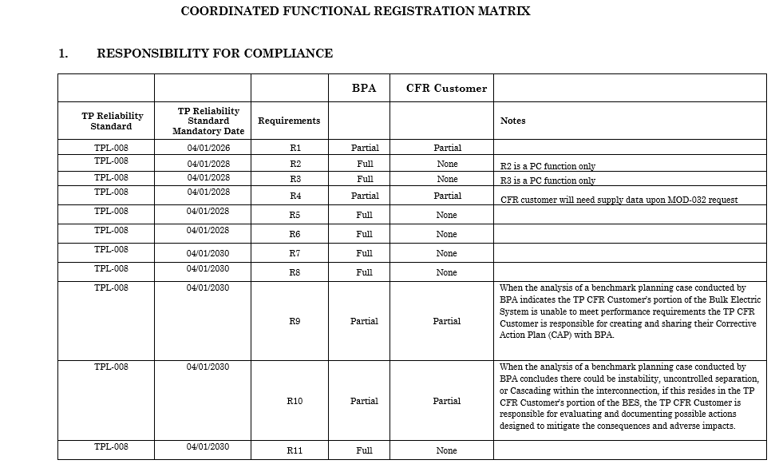
TPL-008-1

Slide 22
TPIP V7 UPDATES
Cost allocation
New Process
Minor updates to TPL-007-4 section

Slide 23
TP CFR KEY DATES
September
Compliance Packet Distribution
TPIP V7 Customer Review of Redline
October
Annual TP CFR Cost Send Outs
Short Circuit Analysis Begins
January
Matrix Update (adding TPL-008-1)
Distribute Short Circuit Summary

Slide 24
QUESTIONS

Slide 25
Contact us: csrp@bpa.gov Lorissa Cardoza – CSRP Supervisor
TOP/TP CFR TEAM Megan Walden Alesia Crisman Debbie Dunn Kristin Judge

