Slide 1
Bonneville Power Administration
JPM Investor Forum
March 2025

Slide 2
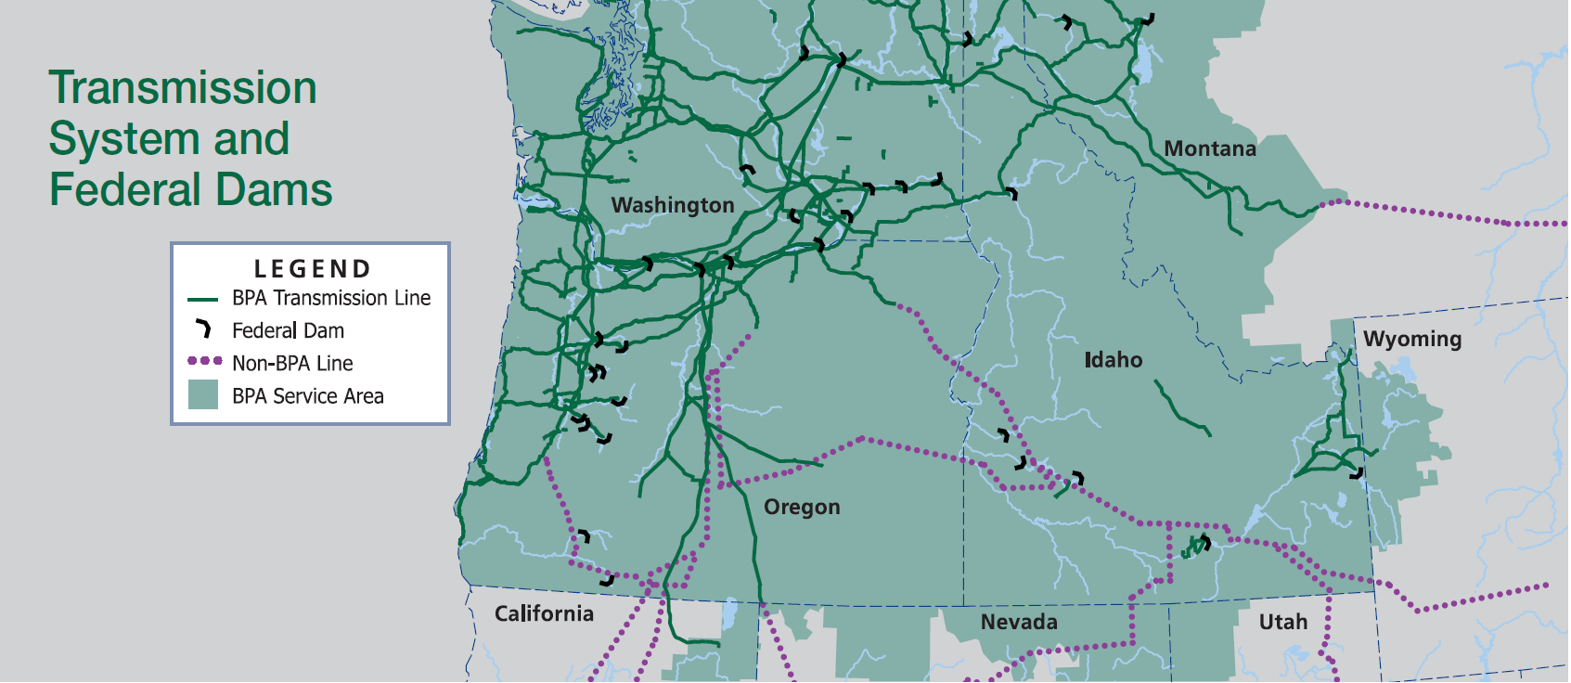
BPA at a Glance
As one of four regional Federal power marketing administrations, BPA’s service area spans roughly 300,000 square miles across all or portions of eight states and includes nearly 15,000 circuit miles of transmission lines
BPA Service Area Overview
Key BPA Statistics
28% | BPA share of electric power consumed in the PNW
$35/MWh | BP24 Average effective Tier 1 rate
~75% | BPA share of bulk transmission capacity in the PNW
$5 billion | Capital program size for “Evolving Grid” transmission projects
140+ | Power Customers
400+ | Transmission Customers
Vancouver, WA
BPA Transmission Facilities
Portland, OR
BPA Headquarters
2

Slide 3
Key Credit Strengths
BPA’s current ratings: Moody’s: Aa1, Negative Fitch: AA, Stable S&P: AA-, Stable
Funding
Sources
  Self-financed since 1974 using revenue earned in rates from delivery of power and transmission services; Not directly affected by a government “shut down” due to a lapse in appropriations
  Access to capital through both Federal and Non-Federal sources
  Revolving authority to borrow up to $13.7 billion in bonds from the U.S. Treasury, increasing to $17.7 billion at the start of FY28; $7.7 billion available as of 9/30/24
Non-Federal Payment Priority & Financial Reserves
  Cash payments for Non-Federal debt are made before payments by BPA to the U.S. Treasury
  BPA maintains substantial cash and short-term investment balances in addition to having access to a $750 million U.S. Treasury line of credit
Cost Recovery
  BPA is required by law to establish rates to recover all costs
  FERC reviews rates to ensure compliance with statutory requirement for BPA to recover all costs through rates

Slide 4
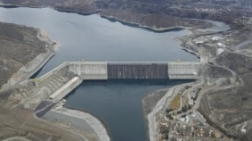
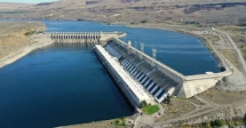
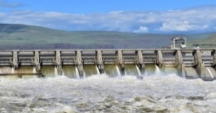
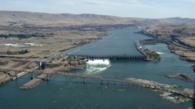
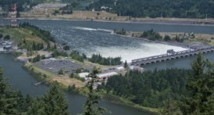
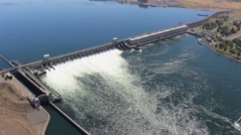
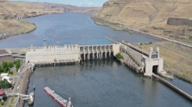
Power Generation Overview
BPA markets wholesale electrical power from 31 Federal hydroelectric dams in the Northwest, one Non-Federal nuclear plant, and several small Non-Federal power plants totaling 23,105 MW of capacity
Operated by the U.S. Army Corps of Engineers or the Bureau of Reclamation
Federal Hydroelectric
Carbon Emission-Free
Columbia Generating Station (Nuclear)
Carbon Emission-Free
Contract Purchases and Other Resources
Owned and operated by Energy Northwest
Abundant, reliable, affordable and secure energy
6,677aMW
84%
994aMW
12%
291aMW
4%
Select BPA Hydro Projects
Grand Coulee
33 Units
6,684 MW*
Chief Joseph
27 Units
2,614 MW*
John Day
16 Units
2,480 MW*
The Dalles
22 Units
2,080 MW*
Bonneville
18 Units
1,221 MW*
McNary
14 Units
1,120 MW*
Lower Monumental
6 Units
930 MW*
Note: 24 additional projects not pictured, 51 Units, 2,254 MW*; 1 nuclear power plant, 1 Unit, 1,169 MW (rated capacity); totals on page may not add due to rounding
*BPA White Book

Slide 5
Fiscal Year 2023-2024 Financial Results
Under BPA’s Power and Transmission Reserves Distribution Clauses, rate reductions from excess reserves took place in FY23 and FY24, resulting in lower revenues that were still sufficient to meet Non-Federal and Federal obligations
Select FY2023 Financial Results
Select FY2024 Financial Results
Total Operating Revenues | $4.2 billion Includes $363 million rate reduction from FY22 Power & Transmission RDCs
Net Operating Revenues | $94 million
FYE RAR | $1.3 billion $923mm Power Services’ RAR $363mm Transmission Services’ RAR
Financial Reserves Policy - RDC | Power $285 million Transmission $130 million
FYE DCOH | 193 Days
Total Operating Revenues | $4.6 billion Includes $165 million rate reduction from FY23 Power RDC
Net Operating Revenues | $212 million
FYE RAR | $823.3 million $507mm Power Services’ RAR $316mm Transmission Services’ RAR
Financial Reserves Policy - RDC | Transmission $83 million
FYE DCOH | 116 Days
Strong Reserves Available for Risk (RAR) resulted in RDCs in both FY23 and FY24
41st consecutive Treasury payment was made in full and on time at the end of FY24
Power is on track to meet 60% leverage ratio target by 2040; Transmission off track due to Evolving Grid expansion

Slide 6
Historical Debt Service Coverage¹
BPA’s Non-Federal payment obligations are made before any other payments, resulting in strong Non-Federal Debt Service Coverage Ratios that have averaged 4.6x over the last five years
($ millions, excluding ratios) | FY20 | FY21 | FY22 | FY23 | FY24
Total Operating Revenues (A) | $3,684 | $3,823 | $4,722 | $4,248 | $4,569
Total Operating Expenses² (B) | $1,778 | $1,996 | $2,144 | $2,848 | $2,992
Funds Available to meet Non-Federal Debt Service [(A)-(B)=(C)] | $1,906 | $1,827 | $2,578 | $1,400 | $1,577
Non-Federal Debt Service (D) | $462 | $336 | $357 | $390 | $588
Non-Federal Debt Service Coverage Ratio [(C)/(D)=(E)] | 4.1x | 5.4x | 7.2x | 3.6x | 2.7x
Scheduled Treasury Payments (F) | $715 | $637 | $605 | $596 | $598
Advanced Treasury Payments (G) | $20 | $412 | $346 | $426 | $194
Total Treasury Payment [(F)+(G)=(H)] | $736 | $1,049 | $951 | $1,021 | $792
Advanced Treasury Payments are paid with additional cash in the Bonneville Fund resulting from the second phase
of the Regional Cooperation Debt Program and the prior fiscal year RDC
1
2
¹This information is presented in Official Statements for BPA-backed, Non-Federal Debt bond issuances. BPA’s audited financial statements do not include a similar table.
²Operating Expenses include the following items from the Federal System Statement of Revenues and Expenses: BPA O&M, Purchased Power, Non-Federal entities O&M-net billed, Non-Federal entities O&M non-net-billed, and the Residential Exchange Program. Operating Expenses do not include certain payments to the Corps and Reclamation.
6

Slide 7
Debt Outstanding & Payment Obligations
BPA must first fulfill its payment obligations related to $7.3 billion of debt issued by Energy Northwest, Port of Morrow, and IERA, followed by the repayment of U.S. Treasury borrowings and Federal appropriation obligations
Non-Federal Obligations
Borrowings from
U.S. Treasury
Federal Appropriation
Repayment Obligations
$7.3 billion
50%
$6.0 billion
40%
$1.7 billion
10%
“Other” includes outstanding bonds issued by Northern Wasco County People’s Utility District, Public Utility District No. 1 of Lewis County, and Northwest Infrastructure Financing Corporation
Current authorized borrowing authority of $13.7 billion, increasing to $17.7 billion in FY28. Facility is revolving
BPA repays amounts that have been appropriated by Congress to our federal partners for capital investments in the Federal System
BPA recently implemented a Sustainable Capital Financing policy to shift away from 100% debt financing of capital and to incorporate revenue financing as a predictable and consistent method of funding capital, with goal to achieve a maximum 60% debt-to-asset ratio goal by 2040
7

Slide 8
Looking to the Future
BP26 Rate Case:
  Initial proposal includes average rate increases of 10.8% for Power and 24.1% for Transmission, after years of holding rate increases at or below inflation.
  The Administrator will decide on final Power and Transmission rates in Jul 2025. Until then, it remains in ex parte.
Post-2028 Power Contracts: Under development with 19-year terms; expected execution in Dec 2025.
Day Ahead Market Participation: Draft decision to join Southwest Power Pool’s Markets+ just released, with final decision expected in May 2025.
BPA Transmission Expansion:
  Accelerating work on ~$5 billion of 20 regionally needed “Evolving Grid” expansion projects.
  Transitioned from first-come/first-served generation interconnection to first-ready/first-served.
  Exploring Transmission Service Request queue improvements; includes 65 GW of unstudied service requests.

Slide 9
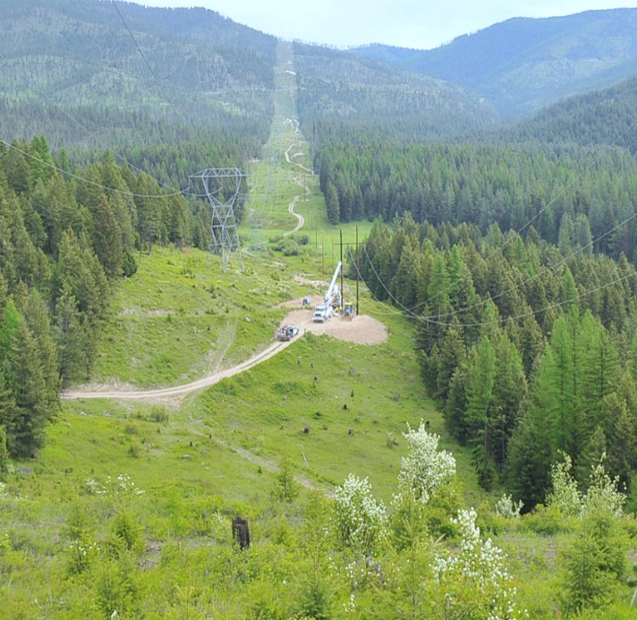
Wildfire Risk Mitigation
BPA works to ensure system reliability while mitigating the risk of wildfires through comprehensive vegetation management and wildfire mitigation programs
Tiered Approach
System Hardening: Robust vegetation management program to minimize risk
Situational Awareness Monitoring: Enhanced weather monitoring and forecasting; Asset management tools used to understand criticality, health & risk
Wildfire Season: Utilize enhanced protection and control settings
Extreme Risk Days: Stand up Public Safety Power Shutoff (PSPS) decision making team
Activate PSPS: Last resort, BPA triggers the PSPS
Wildfire Liability
Tort Claims: All settlements or court judgments from tort claims are paid by the US Judgment Fund, not the Bonneville Fund
Other Claims: An inverse condemnation complaint was filed in the US Court of Federal Claims in Washington DC. BPA is unable to predict whether any settlements or judgments arising from this suit would be paid from the US Judgment Fund or the Bonneville Fund
9

Slide 10
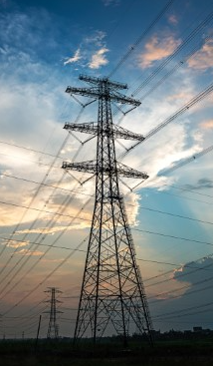
Managing Cyber & Physical Asset Security
BPA is focused on preparedness to withstand growing risk factors related to physical security and cyber security
Cyber Security
  Implementation & monitoring of real time cyber security controls by permanent, full-time team
  Coordination with other the federal government agencies
  Subject to mandatory NERC reliability standards including Critical Infrastructure cybersecurity standards
  24x7 Cyber Security Operations and Analysis Center
  Redundant system control centers, geographically separated
Physical Asset Security
  Strategy in place to deter, detect, delay, assess, communicate and respond to security-related events
  Actions: physical hardening; contract security officers; systems for physical access control, intrusion detection, and video surveillance
  Permanent, full-time team dedicated to monitoring threats; coordination with local, state and federal government agencies
10

Slide 11
Summary of Key Credit Strengths
1
Essential Service Provider | 300,000 square miles of service territory across 8 states and serving approximately 15 million people Provides about 28% of the electricity consumed in the region and has a 75% share of bulk transmission capacity in the PNW
Diverse and Long-Tenor Customer Base | Maintains long-term contracts with over 140 power customers and more than 400 transmission customers Engaged in the Provider of Choice Initiative to secure long-term power sales contracts post-2028 Customer base includes cooperatives, municipalities, investor-owned utilities, tribal utilities, and federal agencies
Majority Carbon-Free Power Resources | 23,105 MW of renewable capacity across 31 hydro projects and 1 nuclear power plant Meeting regional customer demand for reduced carbon emissions
Risk Mitigation & Environmental Stewardship | Tiered vegetation and wildfire mitigation approach inclusive of a comprehensive Vegetation Management Plan Real time physical and cybersecurity strategies in place to protect critical infrastructure Recognized for environmental stewardship with awards for habitat conservation and restoration project
Robust Financial Strength and Debt Service Coverage | Sustainable Capital Financing policy utilizing revenue financing with aim to achieve a 60% debt-to-asset ratio by 2040 Strong liquidity with RAR approximately $825 million and access to a $750 million U.S. Treasury credit facility Demonstrated strong debt service coverage with Non-Federal Debt Service Coverage Ratio averaging 4.6x since 2020
2
3
4
5
11

Slide 12


Upcoming Transactions*
  BPA collaborates with Energy Northwest to issue non-federal debt which is fully secured by BPA under existing net billing agreements.
  The Port of Morrow and the Idaho Energy Resources Authority finance transmission projects with publicly issued bonds and credit arrangements which are fully secured by BPA lease-purchase commitments.
  Energy Northwest issuance of approximately $982,000,000 is currently expected to price on or about May 1, 2025.
  Bond proceeds are expected to finance new money capital, take out a short-term line of credit used for FY25 fuel purchases, and refinance certain outstanding debt for the Columbia Generating Station and Projects 1 and 3.
  Approximately $873,000,000 in tax-exempt bonds are anticipated to amortize between 2026 – 2043, and $109,000,000 in taxable bonds are anticipated to amortize between 2027 - 2030.
  The banking syndicate includes J.P. Morgan, Wells Fargo, and Bank of America.
  Idaho Energy Resources Authority (IERA) issuance of approximately $110,000,000 in taxable bonds are currently expected to price in July.
  Bond proceeds are expected to pay off existing Port of Morrow debt and extend maturities to align with the useful lives of the underlying assets.
  The banking syndicate includes Bank of America and Wells Fargo.
  *Preliminary, subject to change; when, as, and if issued. There is no guarantee that all or a portion of the Bonds will be offered, sold or issued.

Slide 13
Contacts
Nadine M. Coseo
Treasury Manager, Financial Strategy & Operations
(503) 230-3337
nmcoseo@bpa.gov
Ethan D. Postrel
Manager of Revenue Requirement, Repayment & Financial Strategy
(503) 230-4759
edpostrel@bpa.gov
13

