Slide 1
BPA IP Color Palette
142/188/222
5/153/102
64/142/200
34/81/116
3/77/52
202/254/222
Bonneville Power Administration
Bonneville Power Administration
Credit Presentation
Investor Presentation
As of June 24, 2025

Slide 2
Disclaimer
The information in this investor presentation is a summary of certain information concerning the Bonneville Power Administration (“BPA”) and is not intended to contain all information material to investors. This investor presentation is provided for your information and convenience only. This investor presentation does not constitute a recommendation or an offer or solicitation for the purchase or sale of any security or other financial instrument or to adopt any investment strategy. In no event shall BPA be liable for any use by any party of, or any decision made or action taken by any party in reliance upon the information contained herein. BPA makes no representations as to the legal, tax or accounting treatment of any BPA-supported security. You should consult with your own advisors as to such matters and the consequences of the purchase and ownership of BPA-supported securities. Past performance is not indicative of future performance, which will vary.
This investor presentation you are about to view is provided as of June 24, 2025. If you are viewing this presentation after June 24, 2025, there may have been events that occurred subsequent to such date that would have a material adverse effect on the financial information that is presented herein, and BPA has not undertaken any obligation to update this investor presentation.
This investor presentation contains statements which, to the extent they are not recitations of historical fact, may constitute “forward-looking statements.” In this respect, the words “estimate,” “project,” “anticipate,” “expect,” “intend,” “believe” and similar expressions are intended to identify forward-looking statements. A number of important factors affecting BPA’s business and financial results could cause actual results to differ materially from those stated in the forward-looking statements.
Bonds supported by BPA’s financial obligations and the obligations of BPA providing such support are not nor shall they be construed to be general obligations of the United States of America nor are such bonds or obligations intended to be or are they secured by the full faith and credit of the United States of America.

Slide 3
Idaho Energy Resources Authority Transmission Facilities Revenue Bonds
Bonneville Cooperation Project No.3
Series 2025 (Federally Taxable)
Transaction Summary
Pricing Date* | July 8, 2025
Par Amount* | $90,235,000
Maturities (September 1)* | 2043 and 2048
Settlement Date* | July 24, 2025
Tax Status | Federally Taxable
Ratings (Moody’s / Fitch) | Aa2 (Stable) | AA (Stable)
Issuer | Idaho Energy Resources Authority (“IERA”)
Obligor | Bonneville Power Administration (“BPA”)
Bond Counsel | Chapman and Cutler
Municipal Advisor | PFM Financial Advisors, LLC
Senior Manager | BofA Securities
Co-Manager | Wells Fargo Securities
The Series 2025 Bonds are being issued for the principal purpose of acquiring certain transmission assets to be leased by the Issuer to Bonneville
*Preliminary, subject to change; when, as, and if issued.

Slide 4
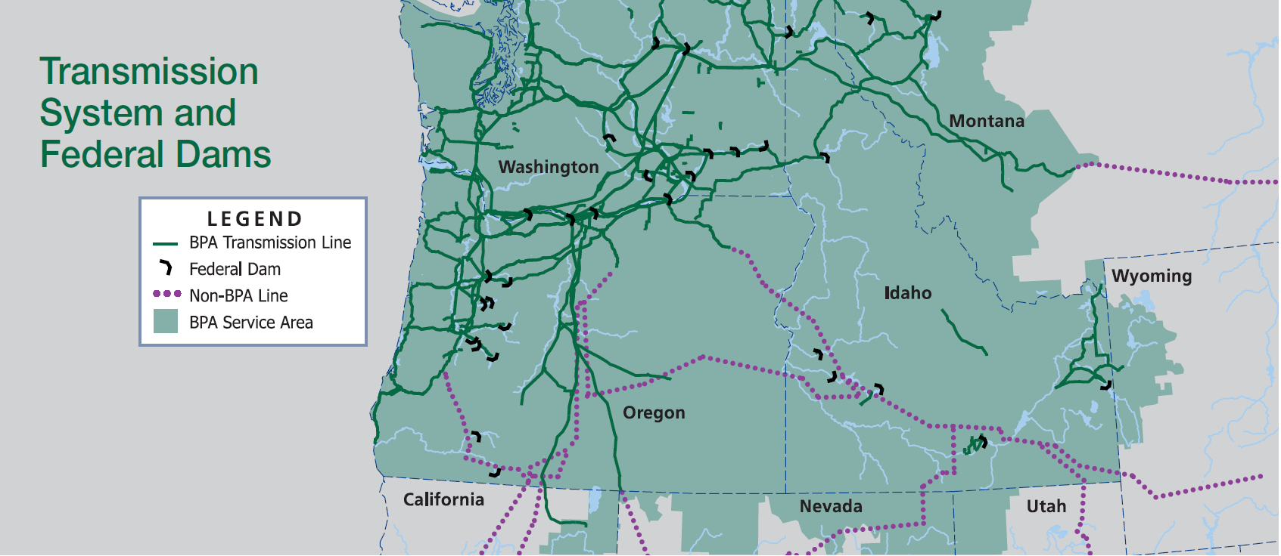
BPA at a Glance
As one of four regional Federal power marketing administrations, BPA’s service area spans roughly 300,000 square miles across all or portions of eight states and includes more than 15,000 circuit miles of transmission lines
BPA Service Area Overview
Key BPA Statistics
32% | BPA share of electric power generated in the Pacific Northwest (“PNW”)
$35/MWh | BP24 Average effective Tier 1 rate
~75% | BPA share of bulk transmission capacity in the PNW
$4.6 billion | FY2024 Operating Revenues
140+ | Power Customers
400+ | Transmission Customers
Vancouver, WA BPA Transmission Facilities
Portland, OR BPA Headquarters

Slide 5
Summary of Key Credit Strengths
BPA's fundamental credit strengths include access to multiple capital sources, a cost recovery mandate, priority of non-federal debt payments, and a long-term strategic financial plan
Essential Service with Long-Term Customers
Provides about 32% of the electricity generated in the region and has an approximately 75% share of bulk transmission capacity in the PNW
Maintains long-term contracts with over 140 power customers and more than 400 transmission customers
Funding
Sources
Self-financed through revenue earned from delivery of power and transmission services; Not subject to government “shut down” due to a lapse in appropriations
Access to capital through both Federal and Non-Federal sources
Cost
Recovery
BPA is required by law to establish rates to recover all costs
FERC reviews rates to ensure compliance with statutory requirement for BPA to recover all costs through rates
Priority of Payment and Financial Reserves
Cash payments for Non-Federal debt are made before payments by BPA to the U.S. Treasury
BPA maintains substantial cash and short-term investment balances in addition to a $750 million U.S. Treasury line of credit
Strategic Debt Management
Sustainable Capital Financing Policy utilizing revenue financing with aim to achieve a 60% debt-to-asset ratio by 2040
Demonstrated strong debt service coverage with Non-Federal Debt Service Coverage Ratio averaging 4.5x since 2022

Slide 6
Table of Contents
1
BPA Overview & History
2
Risk Mitigation
3
rates & Available Funds
4
Historical Performance
5
Capital Plan & Debt Information
6
Series 2025 structure & Timeline

Slide 7
COMPANY OVERVIEW
BPA Overview & History

Slide 8
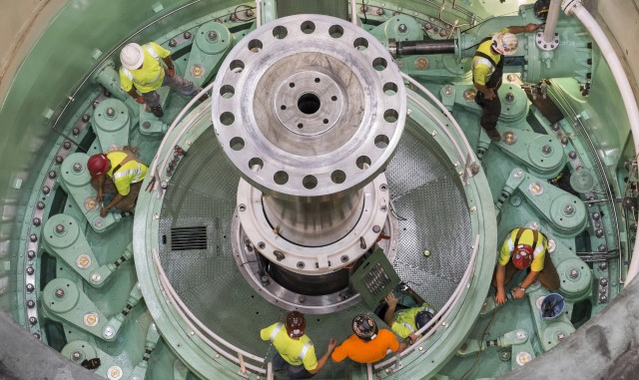
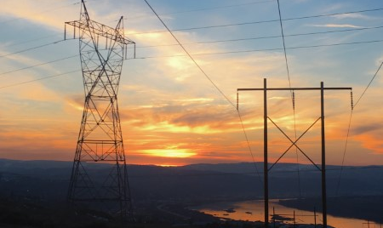
BPA: One Agency, Two Business Units
BPA not only markets power that provides 32% of the electricity generated in its service area, but also maintains more than 15,000 miles of high voltage transmission lines
BPA Power Services Overview
Provides about 32% of the electricity generated in the region
Markets power from 31 Federally-owned hydroelectric projects and several Non-Federal projects, including the Columbia Generating Station
Approximately 135 preference customers within the region that pay wholesale prices, which include publicly-owned, cooperatively-owned, and tribal utilities
BPA projects meeting nearly 8,000 annual average MW of load in Operating Year 2026, of which roughly 89% is forecast to be Preference Customer loads
$3.4 billion in revenue in FY24
Chief Joseph Dam
BPA Transmission Services Overview
More than 15,000 circuit miles of high voltage lines
259 substations
Approximately 300,000 square miles of service territory covering approximately 15 million people
$1.2 billion in revenue in FY24
High Voltage Transmission
8

Slide 9
BPA’s Unique Role
In addition to marketing and transmitting power from both Federal and Non-Federal sources, BPA also has a variety of both Federal and Non-Federal debt obligations repaid through revenues
Non-Federal Relationships & Obligations*
Federal Relationships & Obligations
Idaho Energy Resources Authority (“IERA”) and BPA have entered into lease-purchase arrangements that secure bonds issued by IERA, in order to support BPA’s transmission capital program
Port of Morrow (“POM”) and BPA have entered into lease-purchase arrangements that secure bonds issued by POM, in order to support BPA’s transmission capital program
Energy Northwest (“EN”) and BPA have worked together since 2001 to refinance certain maturities to more closely match the expected useful lives Arrangement allows EN debt to be refinanced and extended through 2030 to reduce costs to rate payers while also funding new capital projects at EN’s Columbia Generating Station nuclear plant BPA fully supports these debt obligations through Net Billing Agreements
BPA is authorized to issue and sell bonds to the U.S. Treasury to fund Federal Columbia River Power System (FCRPS)-related capital investments and operating expenses
-BPA may have up to $13.7 billion aggregate principal amount of bonds outstanding at any given time, increasing to $17.7 billion in FY28
-Within this authority, BPA may also access a $750 million line of credit with the U.S. Treasury to fund operating expenses
BPA repays amounts that have been appropriated by Congress to our Federal partners for power-related capital investments in the Federal system
*Other non-federal obligations include BPA supported debt issued through Northwest Infrastructure Financing Corporation and Public Utility District No. 1 of Lewis County, Washington
9

Slide 10
Transmission Overview
BPA provides approximately 75% of the bulk transmission capacity in the region and is actively seeking ways to improve interconnection queue times
BPA is the largest high-voltage transmission provider in the Pacific Northwest
From 2000 to 2024, BPA interconnected more than 6 GW of renewable resources into the region’s power grid
As part of its Vegetation Management Plan, BPA establishes and maintains vegetation with a mature height or growth that is 25 feet below the maximum sag of the transmission lines
BPA Cluster Study Map and Regions
BPA Transmission Expansion Efforts
BPA is embarking on a strategy to meet customer needs driven by the development of new power generation projects, primarily wind and solar generation, both inside and outside the Region
In Fiscal Year 2023, Bonneville started a proceeding to improve process efficiencies for interconnection requests and continues to develop revised business practices
Bonneville generally employs a cluster approach wherein it aggregates pending requests for transmission service to study and evaluate the new transmission facilities that it would have to construct to provide that service
134 Interconnection Requests
73.8 GW Nameplate
~50 GW Requested Interconnection Service Level
BPA Facilities are shown in orange
Dots are Interconnection Request Location
10

Slide 11
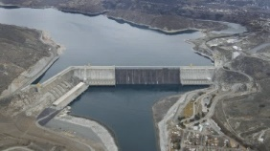
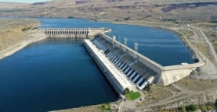
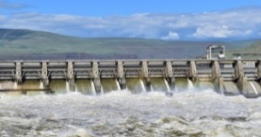
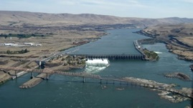
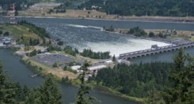
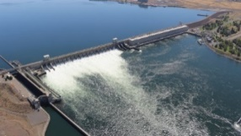
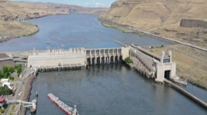
Power Generation Overview
BPA markets wholesale electrical power from 31 Federal hydroelectric dams in the Pacific Northwest, one Non-Federal nuclear plant, and several small Non-Federal power plants, and contracts, totaling 23,852 MW of capacity
Operated by the U.S. Army Corps of Engineers or the Bureau of Reclamation
Federal Hydroelectric
Carbon Emission-Free
Columbia Generating Station (Nuclear)
Carbon Emission-Free
Contract Purchases and Other Resources
Owned and operated by Energy Northwest
Abundant, reliable, affordable and secure energy
6,601aMW
83%
1,116aMW
14%
266aMW
3%
Select BPA Hydro Projects
Grand Coulee
33 Units
6,998 MW*
Chief Joseph
27 Units
2,614 MW*
John Day
16 Units
2,480 MW*
The Dalles
22 Units
2,080 MW*
Bonneville
18 Units
1,221 MW*
McNary
14 Units
1,120 MW*
Lower Monumental
6 Units
930 MW*
Note: 24 additional projects not pictured, 69 Units, 4,807 MW*; 1 nuclear power plant, 1 Unit, 1,178 MW (rated capacity); totals on page may not add due to rounding.
*Maximum Capacity. Source: 2025 Pacific Northwest Loads and Resources Study, Bonneville, May 2025. Reflects firm energy for operating year 2026
11

Slide 12
Looking to the Future
1
BP26 Rate Case
Initial Proposal includes average rate increases of ~10.8% for Power and ~24.1% for Transmission, after years of holding rate increases at or below inflation
Final Power and Transmission rates will be issued in late July 2025
2
Post-2028 Power Contracts
Under development with 19-year terms; expected execution in December 2025
3
Day Ahead Market Participation
On May 9, 2025, BPA issued its Day-Ahead Market Policy which established the agency’s intent to pursue participation in Southwest Power Pool’s Markets+ day-ahead market
4
BPA Transmission Expansion
Accelerating work on ~$5 billion of regionally important “Evolving Grid” expansion projects.
The expansion projects will significantly increase the capacity and reliability of the Pacific Northwest grid and its ability to integrate new energy sources
Transitioned from first-come/first-served generation interconnection to first-ready/first-served
12

Slide 13
COMPANY OVERVIEW
Risk Mitigation

Slide 14
Wildfire Risk Mitigation
BPA works to ensure system reliability while mitigating the risk of wildfires through comprehensive vegetation management and wildfire mitigation programs
Tiered Approach
System Hardening: Annual work plans consider the risk of fire, and the environmental restrictions associated with threatened and endangered species
Situational Awareness Monitoring: Enhanced weather monitoring and forecasting; Asset management tools used to understand criticality, health & risk
Wildfire Season: Utilize enhanced protection and control settings
Extreme Risk Days: Stand up Public Safety Power Shutoff (“PSPS”) decision making team
Activate PSPS: Last resort, BPA triggers the PSPS
Wildfire Claims
Tort Claims: All settlements or court judgments from tort claims are paid by the U.S. Judgment Fund, not the Bonneville Fund
Other Claims: In 2023, the U.S. Department of Justice was served with an inverse condemnation complaint filed in the U.S. Court of Federal Claims in Washington DC. Bonneville is unable to predict with certainty whether any settlements or judgments arising from this suit would be paid from the U.S. Judgment Fund or the Bonneville Fund. Although Bonneville does not have a track record with source of payment for any past inverse condemnation settlements or judgments, similar suits against other federal agencies have been paid from the Judgment Fund, and the U.S. Treasury has indicated the Judgment Fund would be available to pay settlements or judgments arising from this case.
14

Slide 15
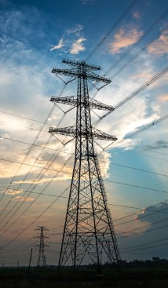
Managing Cyber & Physical Asset Security
BPA is focused on preparedness to withstand growing risk factors related to cyber security and physical security
Cyber Security
Implementation & monitoring of real-time cyber security controls by permanent, full-time team
Coordination with other federal government agencies
Subject to mandatory NERC reliability standards including Critical Infrastructure Protection standards
24x7 Cyber Security Operations and Analysis Center
Redundant system control centers, geographically separated
Physical Asset Security
Strategy in place to deter, detect, delay, assess, communicate and respond to security-related events
Actions: physical hardening; contract security officers; systems for physical access control, intrusion detection, and video surveillance
Permanent, full-time team dedicated to monitoring threats; coordination with local, state and federal government agencies
15

Slide 16
COMPANY OVERVIEW
Rates & Available Funds

Slide 17
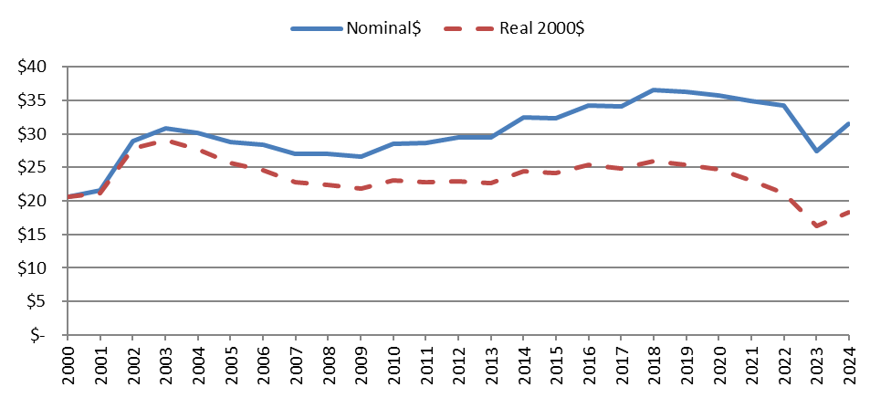
Historical Power Rates
Rates have remained relatively stable, especially on an inflation-adjusted basis
Historical Average PF Preference Rates
Nominal (Actual) and Real (Inflation-Adjusted) Average PF Preference Rate Levels
$Dollars per Megawatt Hour
Fiscal Year
FY 22 through 24 includes the effect of RDC PF = Priority Firm Power
17

Slide 18
Priority of Payments
BPA’s payments to the U.S. Treasury are made only from net proceeds after all costs, including debt service on BPA supported Bonds, have been met
Power Services Revenues
Bonneville Fund
Transmission Services Revenues
First Order of Payment
Energy Northwest BPA-Supported Bonds, O&M, and debt service
Other Non-Federal Payments and BPA Lease Purchase Arrangements for Transmission Capital Program (IERA, POM, Lewis County, and NIFC-Related)
O&M Expenses
Other Expenses
1
There is no explicit priority of Non-Federal payments
BPA Net Proceeds After Non-Federal Payments
Second Order of Payment
Principal and Interest on Bonds and Line of Credit with the U.S. Treasury
Principal and interest to repay federal appropriations that funded capital investments in the Federal System
Any Deferred Federal Interest & Principal
2

Slide 19
Additional Assurances of Non-Federal Payment
While BPA’s rate setting process is designed to ensure full cost recovery, and priority is statutorily guaranteed to BPA’s Non-Federal obligations, additional measures provide downside protection for Non-Federal obligations
Option 1 | Utilize Reserves | BPA may utilize its Power Services’ RAR and/or Transmission Services’ RAR (collectively, the “Total RAR”) within a fiscal year
Option 2 | Access U.S. Treasury Short-Term Credit Facility | BPA maintains overnight access to a $750 million line of credit with the U.S. Treasury to address unmet costs, including Non-Federal obligations and operating costs
Option 3 | Employ the Financial Reserves Policy (“FRP”) Surcharge and/or Cost Recovery Adjustment Clause (“CRAC”) | The Surcharge and CRAC are automatic rate adjustments that trigger when actual fiscal year end RAR by business unit fall below certain thresholds; the rate adjustments are effective December 1 through September 30 of the applicable year
Option 4 | Undertake Expedited Rate Case | BPA also reserves the right to initiate an expedited rate case proceeding to increase Power and/or Transmission Services rates during a rate period, a process estimated to take up to six months to complete
Reserves Available for Risk (“RAR”) - cash & investments held in the Bonneville Fund that are a result of operations (plus any deferred borrowing). Distinct from Reserves Not Available for Risk which are funds held for specific purposes, e.g. study deposits from customers
BPA has never failed to meet its Non-Federal obligations and has made all scheduled U.S. Treasury payments on time and in full for the last 41 consecutive years
19

Slide 20
BPA Financial Reserves
In addition to a $750 million short-term credit facility with the U.S. Treasury, BPA also maintains Reserves Available for Risk as well as a process to increase rates without a formal rate process in times of RAR stress
Financial reserves additional to the $750 million U.S. Treasury facility fluctuate throughout the year based upon a variety of factors
Year-End Reserves ($ Millions)
Fiscal Year | Total Financial Reserves | Reserves Available for Risk | United States Treasury Short-Term Credit Facility | Days Liquidity on Hand¹
2020 | $889 | $708 | $750 | 295
2021 | 1,056 | 825 | 750 | 284
2022 | 1,834 | 1,511 | 750 | 380
2023 | 1,727 | 1,287 | 750 | 258
2024 | 1,299 | 823 | 750 | 189
Cash, cash equivalents, and readily-liquidated U.S. Treasury securities held in BPA’s account at the U.S. Treasury
RAR reflects a BPA financial metric used to measure accumulated financial reserves derived from operations and are generally lower than Total Financial Reserves, as certain reserves are already committed to pay other expenses
The U.S. Treasury facility provides additional liquidity
¹Operating Expenses used for the Days Liquidity on Hand calculation include the following items from the Federal System Statement of Revenues and Expenses: BPA O&M, Purchased Power, Non-Federal entities O&M-net billed, Non-Federal entities O&M non-net-billed, and the Residential Exchange Program. Operating Expenses do not include certain payments to the Corps and Reclamation.
20

Slide 21
COMPANY OVERVIEW
Historical Performance

Slide 22
Net Revenue Stability
BPA’s operating revenue to operating expense relationship has remained relatively stable even considering wide variances in stream-flows and hydro-generation, driven by sales of firm energy and transmission services
Note: Streamflow data is based on the Operating Year (Aug 1 – July 31) and the financial information is based on the Fiscal Year (Oct 1 – Sept 30)
22

Slide 23
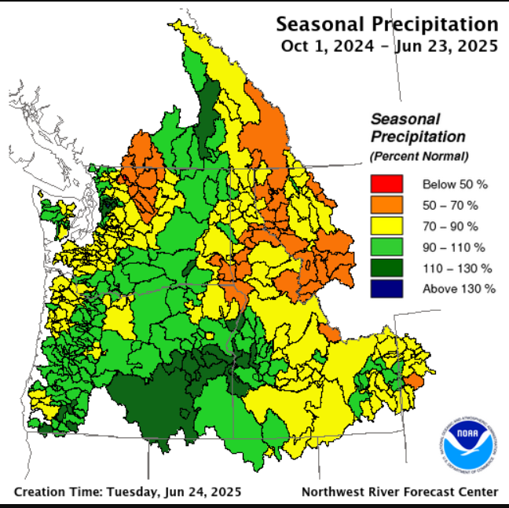
Seasonal Surplus Sales
Over the last 5 years, revenues from net surplus seasonal energy sales have averaged approximately 20% of BPA’s total operating revenues
The amount of energy produced by the hydroelectric system above firm energy may be sold outside of the region
These expected sales of seasonal surplus (secondary) energy is an important part of BPA’s ratemaking and risk mitigation
Under median water conditions, this amount is estimated to be 991 aMW (Operating Year 2026)
Final 2024-2025 Rates assumed revenue from net seasonal surplus energy sales would average approximately $362 million per fiscal year of the rate period
Equivalent to approximately 8% of BPA’s total FY24 operating revenues of $4.6 billion
As part of joining the Western Energy Imbalance Market in 2022, BPA may sell surplus energy and capacity across all participants versus solely in its borders, creating the potential for additional revenue generation
23

Slide 24
Fiscal Year 2023-2024 Financial Results
Under BPA’s Power and Transmission Reserves Distribution Clauses, rate reductions from excess reserves took place in FY23 and FY24, resulting in lower revenues that were still sufficient to meet Non-Federal and Federal obligations
Strong Reserves Available for Risk resulted in Reserves Distribution Clauses ("RDCs") in both FY23 and FY24
41st consecutive Treasury payment was made in full and on time at the end of FY24
Power is on track to meet 60% leverage ratio target by 2040; Transmission off track due to Evolving Grid expansion
Select FY2023 Financial Results¹
Select FY2024 Financial Results¹
Total Operating Revenues | $4.2 billion Includes $363 million rate reduction from FY22 Power and Transmission RDCs
Net Operating Revenues | $94 million
FYE RAR | $1.3 billion $924mm Power Services’ RAR $363mm Transmission Services’ RAR
Financial Reserves Policy – RDC | Power $285 million Transmission $130 million
FYE DCOH | 181 Days
Total Operating Revenues | $4.6 billion Includes $165 million rate reduction from FY23 Power RDC
Net Operating Revenues | $212 million
FYE RAR | $823 million $507mm Power Services’ RAR $316mm Transmission Services’ RAR
Financial Reserves Policy – RDC | Transmission $83 million
FYE DCOH | 116 Days
Figures are rounded
24

Slide 25
COMPANY OVERVIEW
Capital Plan & Debt Information

Slide 26
Debt Outstanding & Payment Obligations $15.0 billion outstanding as of 9/30/24
BPA must first fulfill its payment obligations related to $7.3 billion of debt issued by Energy Northwest, Port of Morrow, IERA, and other non-federal issuers followed by the repayment of U.S. Treasury borrowings and Federal appropriation obligations
Non-Federal Obligations
Borrowings from
U.S. Treasury
Federal Appropriation
Repayment Obligations
$7.3 billion
49%
$6.0 billion
40%
$1.7 billion
11%
Energy Northwest $5,230.8 million
Pre Pay $111.7 million
Lease Purchase $1,790.8 million
Other (Wasco, Cowlitz, Lease Finance) $167.9 million
Current authorized borrowing authority of $13.7 billion, increasing to $17.7 billion in FY28. Facility is revolving
BPA repays amounts that have been appropriated by Congress to our federal partners for capital investments in the Federal System
BPA recently implemented a Sustainable Capital Financing Policy to shift away from 100% debt financing of capital and to incorporate revenue financing as a predictable and consistent method of funding capital, with a goal to achieve a maximum 60% debt-to-asset ratio goal by 2040
26

Slide 27
Historical Debt Service Coverage¹
BPA’s Non-Federal payment obligations are made before any other payments, resulting in strong Non-Federal Debt Service Coverage Ratios that have averaged 4.5x over the last three years
($ millions, excluding ratios) | FY22 | FY23 | FY24
Total Operating Revenues² (A) | $4,722 | $4,248 | $4,569
Total Operating Expenses³ (B) | $2,144 | $2,848 | $2,992
Funds Available to meet Non-Federal Debt Service [(A)-(B)=(C)] | $2,578 | $1,400 | $1,577
Non-Federal Debt Service (D) | $357 | $390 | $588
Non-Federal Debt Service Coverage Ratio [(C)/(D)=(E)] | 7.2x | 3.6x | 2.7x
Scheduled Treasury Payments (F) | $605 | $596 | $598
Advanced Treasury Payments (G) | $346 | $426 | $194
Total Treasury Payment [(F)+(G)=(H)] | $951 | $1,022 | $792
Advanced Treasury Payments are paid with additional cash in the Bonneville Fund resulting from the second phase
of the Regional Cooperation Debt Program with Energy Northwest and the prior fiscal year RDC
¹This information is presented in Official Statements for BPA-backed, Non-Federal Debt bond issuances. BPA’s audited financial statements do not include a similar table.
² Reflects rate reductions from excess reserves under BPA’s Power and Transmission Reserves Distribution Clauses.
³Operating Expenses include the following items from the Federal System Statement of Revenues and Expenses: BPA O&M, Purchased Power, Non-Federal entities O&M-net billed, Non-Federal entities O&M non-net-billed, and the Residential Exchange Program. Operating Expenses do not include certain payments to the Corps and Reclamation.
27

Slide 28
BPA Capital Plan excluding Columbia Generating Station
While capital funding is also received by the Corps and Reclamation, BPA maintains a robust capital program in addition to Energy Northwest’s capital plan related to the Columbia Generating Station and other projects
BPA has historically met its capital program needs through U.S. Treasury borrowing and Non-Federal debt, amongst other sources
From FY25-FY34, BPA forecasts planned capital expenditures comparable to or larger than levels in the recent past
Most of BPA’s capital investments involve renewals, upgrades, and replacement of existing facilities and are incremental in nature
Total FY20-24 Capital Spending by Program
$4.1 billion
Forecast Capital Spending by Program and Fiscal Year ($millions)
Project | 2025 | 2026 | 2027 | 2028 | 2029 | 2030 | 2031 | 2032 | 2033 | 2034 | Total
Transmission | $875 | $1,097 | $1,249 | $1,282 | $1,037 | $1,028 | $1,062 | $778 | $804 | $823 | $10,035
Federal System Hydro | 244 | 305 | 309 | 310 | 305 | 307 | 308 | 317 | 328 | 334 | 3,067
Fish & Wildlife | 59 | 50 | 86 | 92 | 124 | 47 | 33 | 38 | 71 | 38 | 638
Facilities, IT & Security AFUDC | 228 | 311 | 326 | 195 | 137 | 142 | 140 | 136 | 140 | 135 | 1,890
Total | $1,406 | $1,763 | $1,970 | $1,879 | $1,603 | $1,524 | $1,543 | $1,269 | $1,343 | $1,330 | $15,630
Total FY20-24 Capital Funding by Source
$4.1 billion
28

Slide 29
COMPANY OVERVIEW
Series 2025 Structure & Timeline

Slide 30
Idaho Energy Resources Authority
Series 2025 Bonds*
Series 2025 Preliminary Amortization*
Series 2025 Schedule*
Maturity Date (September 1) | Principal
2043 | $71,490,000
2048 | $18,745,000
Total | $90,235,000
Date | Event
June 24, 2025 | Post Preliminary Official Statement (POS) and Investor Presentation
July 8, 2025 | Price Series 2025 Bonds
July 24, 2025 | Close Series 2025 Bonds
June 2025 |  |  |  |  |  | July 2025
Mon | Tue | Wed | Thu | Fri |  | Mon | Tue | Wed | Thu | Fri
2 | 3 | 4 | 5 | 6 |  |  | 1 | 2 | 3 | 4
9 | 10 | 11 | 12 | 13 |  | 7 | 8 | 9 | 10 | 11
16 | 17 | 18 | 19 | 20 |  | 14 | 15 | 16 | 17 | 18
23 | 24 | 25 | 26 | 27 |  | 21 | 22 | 23 | 24 | 25
30 |  |  |  |  |  | 28 | 29 | 30 | 31
*Preliminary, subject to change; when, as, and if issued.
30

Slide 31
Contact Information
Bonneville Power Administration
Nadine M. Coseo Treasury Manager, Financial Strategy & Operations (503) 230-3337 nmcoseo@bpa.gov | Ethan D. Postrel Manager of Revenue Requirement, Repayment & Financial Strategy (503) 230-4759 edpostrel@bpa.gov
Darren L. Heim
Manager of Debt & Liquidity Management
(503) 230-3570
dlheim@bpa.gov
31

Slide 32
Thank You
BPA Investor Relations
https://www.bpa.gov/about/finance/investor-relations
EMMA Continuing Disclosure
https://emma.msrb.org/
Idaho Energy Resources Authority: Base CUSIP 451174
Port of Morrow, Oregon: Base CUSIP 73474T
Energy Northwest: Base CUSIP 29270C

