Slide 1


THE VALUE OF ENERGY EFFICIENCY
BONNEVILLE POWER ADMINISTRATION
Brice Lang, BPA EER
October 19, 2022
Notes:
Today, I am going to share with you what BPA sees as the value of our shared work with our utilities on Energy Efficiency.
The work we do together in EE is meaningful to a lot of our stakeholders, but we realized that BPA could be more proactive in characterizing the strategic value of our work.
As the industry has been experiencing a lot of change, we saw an opportunity to examine the many benefits of EE in the face of our current challenges, both presently and in the future.
This presentation—along with our recently published Annual Review document--attempts to provide a comprehensive narrative of the value EE.
By the way, show of hands, who has read that Annual Review or at least peeked at it?

Slide 2
SOME HISTORICAL CONTEXT
  Council set the regional conservation target
  BPA provided infrastructure and set incentive funding; utility customers acquire public power share of target. NEEA leads market transformation.
  Low-cost EE potential was relatively abundant
  Renewable alternatives expensive
  Focus was on energy savings, regardless of time or location
Notes:
Let’s start with some background. Traditionally, every 5-6 years the Power Council sets a regional conservation target that includes all the cost-effective EE that should be acquired by all regional utilities.
BPA has provided program infrastructure and incentive funding that enables our utility customers to acquire around 40% of the regional conservation target. NEEA contributes to advancing EE with their market transformation efforts, which helps clear the path for utilities to acquire conservation.
Historically there has been a relative abundance of the cost-effective EE which was largely driven by cheap lighting measures, as well as the higher cost of alternative power resources.
Finally, our EE programs haven’t put much emphasis on the timing or location of energy savings. In other words, the specific time of day/season or geographic area haven’t been closely integrated into our program design.

Slide 3
CURRENT ENERGY LANDSCAPE
  BPA Resource Program
  Much of low-cost EE acquired
  Alternative resources cheaper
  Regional grid challenges emerging
  Increasing divergence of utility needs
  2028 contract renewals ahead
Notes:
Now, let’s talk about the current energy landscape in which we operate…
In 2018, BPA changed how it performs the Resource Program (RP) which assesses long-term, least-cost power resource acquisition strategies. The amount of EE resource used to be an input into the RP, but in 2018 the methodology was changed so that the RP would now tell us how much EE the BPA system needed as an output. Starting in 2018, BPA began to consider the BPA resource program alongside the Council Plan when thinking about the amount of EE Resource needed.
We’ve successfully acquired a lot of the low hanging, most cost-effective EE. The cost of renewables is coming down and EE isn’t as cheap as it once was. Because of this, efficiency has more competition from cheaper renewables in the Council’s cost models.
Another industry trend that EE is experiencing is the growing emphasis on timing and flexibility of power resources due to the integration of renewables, electrification, and extreme weather events.
It’s also become apparent that there is an increasing divergence of utility needs. It is not new that our customers are highly varied in their interests and needs, but the gap is widening due to new climate policies and the rate of growth in electrification, among other things. Customers at the forefront of electrification will have different needs and challenges than those not pushing forward with electrification.
Of course, all of this plays out as we develop BPA’s Provider of Choice plan, which seeks to renew long-term preference power sales policy and contracts starting in 2028.

Slide 4

What have WE accomplished?
Notes:
Now that I’ve summarized a bit of the history and current landscape, let’s look at what we’ve accomplished and how we view the evolving value of energy efficiency today and in the future.

Slide 5
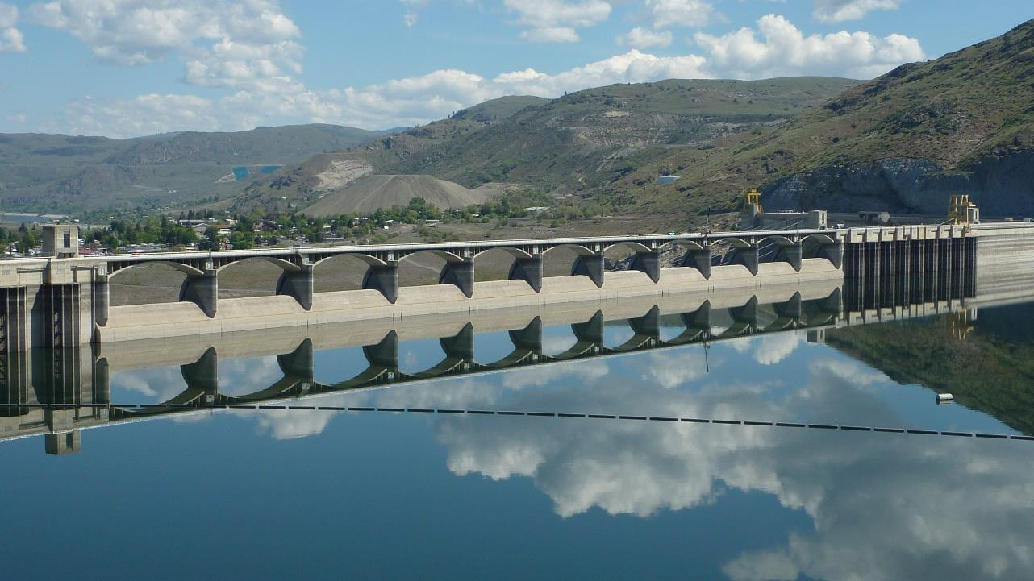
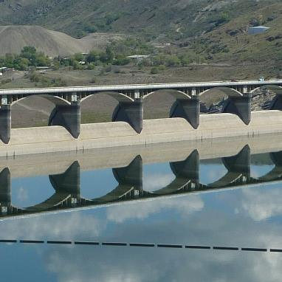

More than 2,505 aMW of EE resource since 1982
Source: 2020 Red Book
Notes:
First and foremost, EE is a real resource that we use to meet system needs. The primary reason we do EE is to meet system needs and to make sure that our preference customers have access to a low-cost, reliable power system.
Over the last 40 years (since 1982), in partnership with our customers we have acquired an EE resource of more than 2,505 aMW.*

Slide 6
To put this into perspective
  The typical annual production of the entire Bonneville system is about 9,800 aMW
  Nearly a quarter of the Federal Columbia River Power System is available to meet current needs because of our EE efforts.
  The average annual output of the Grand Coulee Dam
  Or the enough to power two Seattles
  That’s a lot of resource!
Notes:
To put that in perspective, the typical annual production of the entire Bonneville system is about 9,800 aMW.**
That means about a quarter of the Federal Columbia River Power System is available to meet current needs because of our EE efforts.
That EE resource is also equivalent to the entire Grand Coulee Dam (pictured here)
Or enough to power two Seattles.****
That’s a lot of resource!
---SKIP THE REST…---
You may be wondering what that 2,450 aMW represents: It’s the sum of first-year energy savings every year since 1982. If you’re wondering if it makes sense to add the savings up and talk about it like this—the conventional wisdom from the Council is that people don’t uninstall weatherization and go back to a poorly insulated house. Similarly, people don’t uninstall a high-efficiency heat pump and go back to baseboard strip heat. The savings accumulate beyond the first year, and then when it’s time to replace the equipment at the end of its useful life people will install something at least as efficient as what they had before, if not more efficient. Obviously this isn’t true in 100% of circumstances, but it’s solid enough that it makes a valid planning assumption.
*Sourcing:
2020 Red book: Through FY2020--BPA estimates a cumulative total of 2,357 aMW of energy have been achieved from BPA and its utility customers’ conservation programs since FY 1982.
+Plus 63 aMW in 2021
+Plus 7th Plan period Momentum savings. Not final but definitely greater than 30 aMW
= At least 2,450 aMW
**(source: https://www.nwcouncil.org/reports/columbia-river-history/bpaelectricity).
***(source: https://nwriverpartners.org/wp-content/uploads/2020/02/BPA-Snake-Dams-Fact-Sheet-2016.pdf)
****(source: https://www.nwcouncil.org/reports/columbia-river-history/grandcouleehistory#:~:text=The%20total%20generating%20capacity%20is,cities%20the%20size%20of%20Seattle

Slide 7
2000
2020
Yeah, but is it real?
Yes.
10,000 kwh/year
8,000 kwh/year
Average Seattle City Light Residential Customer Use
Notes:
Because you can’t see the EE resource the same way you can point at a dam, we sometimes get asked: is it real? Can we count on it?
The answer is yes. Not only do we regularly do third-party independent evaluations of our energy savings, but if you look at the last couple of decades of load growth for Seattle City Light, for example, the average Seattleite used 10,000 kWh per year in 2000, compared to 8,000 kWh per year in 2020—a 20% drop, and that’s despite all the new things we plug in!* While many factors contribute to that reduction, efficiency is a significant one.
In the NW more broadly, the energy use per capita fell by 25% between 1990 and 2015 (the last time the Northwest Power Council estimated this figure.)
The Council estimated that roughly 42% of that decline is due to EE, with the rest due to structural changes in the economy. That’s a massive amount of resource region wide.
*(Source: https://www.seattle.gov/Documents/Departments/CityLight/2020IRPProgessReport.pdf)
(Source: https://www.nwcouncil.org/news/energy-efficiency-has-cut-regional-power-use-25-percent-1990)

Slide 8
Pacific Northwest Annual Energy Production, Including Energy Efficiency
40,000
35,000
30,000
25,000
ENERGY GENERATION (aMW)
20,000
15,000
10,000
5,000
2002
2003
2004
2005
2006
2007
2008
2009
2010
2011
2012
2013
2014
2015
2016
2017
2018
2019
YEAR
Hydro
Other
EE
Source: 2021 Power Plan
Notes:
Looking at the regional resource mix over the last 20 years, we see similar trends.
This chart, from the 2021 Power Plan, makes EE’s contribution to the regional resource mix explicit. The dark blue represents electricity production from hydro, the light blue represents all other resources (like nuclear, natural gas, wind, etc.).
The white bars represent the region’s energy needs that EE has already met, meaning that if not for cost-effective EE, the region would have to use other more costly resources to meet those needs.

Slide 9








The EE Resource Brings Many Benefits
Enabling Customer Success
Creating Economic Benefits for the Community
Building a
Resilient Future
Minimizing
Environmental Impacts
Notes:
So clearly EE as a resource is a real thing. And our consistent work over the decades has made a real impact.
While BPA acquires EE primarily as the most cost-effective resource to meet our system needs, there are many other benefits that the agency, our customers, and Northwest communities reap on top of getting a cost-effective resource. Now I’m going to talk about four areas of benefits of EE, which are also very real, even if they can’t always be completely captured in a cost-effectiveness calculation.

Slide 10


Enabling Customer
Success
Notes:
Let’s start with enabling customer success. (1 of 4)

Slide 11





Customers Can Leverage BPA Engineering Expertise To…
Identify EE opportunities
Prioritize measures
Implement measures
Measure and verify savings
Assist in claiming savings
CUSTOMER SUCCESS
Notes:
Many of BPA’s customers simply do not have the bandwidth or technical expertise to help their end-users with projects. That’s where we come in as a giant lever they can pull.
BPA engineers and EE representatives fill in this gap, enabling utilities to do more than they could on their own.
Whether it’s designing a school retrofit, keeping tabs on emerging technologies, or navigating the IM, BPA’s EE staff stretch the capabilities and bandwidth of our customer utilities.
SKIP
------------------------------------------
Information from Debra Bristow (use to speak to slide)
The Engineering Services group is comprised of two sub-teams:
the customer service implementation team which provides expertise in energy efficiency, shaping BPA customer end-use loads, meeting the resource needs of BPA, and
the Energy Efficiency Emerging Technologies team which studies and tests new energy saving technologies for their technical merit and market potential.
Critical Steps for Customer Service
Work with utilities and their end users to identify EE savings opportunities.
Consult with end users and identify specific measures to propose to capture savings.
Assisting with implementation of the EE measures.
Design and implement measurement and verification protocols to quantify savings.
Complete consulting roles to assist in claiming savings.

Slide 12


A positive connection to your customers
CUSTOMER SUCCESS
Notes:
BPA supports our customers by enabling them to have a touch point with their customers—a touchpoint that is something other than their bill, or shutoffs, or other types of hassle.
Additionally, in some areas, BPA utility customers are surrounded by neighboring utilities that have robust EE offerings. BPA’s EE offering allows our customers to keep up with their neighbors and offer their end-users access to similar programs.

Slide 13

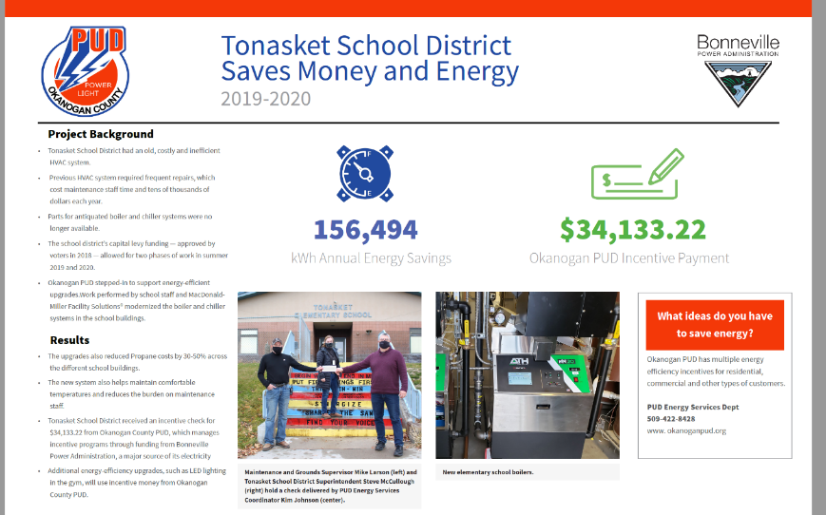
Investing in the community
CUSTOMER SUCCESS
Notes:
BPA’s EE portfolio allows our utilities to make positive contributions to their communities beyond just energy savings.
For example, the Monument Grade School in Monument, Oregon installed a Very-High-Efficiency Dedicated-Outdoor Air-System (VHE DOAS) with BPA utility support (Columbia Power), to improve air circulation, ventilation, and thermal comfort. While the solution reduced HVAC energy use by 60% at the school and overall building energy use by 33%, perhaps even more important -- it improved indoor air quality for a healthier learning environment and reduced risk of transmitting infectious diseases like COVID-19.
Take another example: The Okanogan County PUD, with support from Bonneville, modernized the HVAC systems in Tonasket School District.
Following this project, the school’s energy bills dropped nearly in half, while lowering maintenance burden and making the school more comfortable.
And this is just one example. Between 2016 and 2021, BPA utilities invested more than $3.5 million in approximately 300 schools to acquire *1.7 aMW of energy resource.
Assuming 8cents/kWh, that equates to more than $1.1M annual savings
*Source: Cadeo analysis of BOOM data.
**https://betterbricks.com/uploads/resources/HVAC_Monument-Case-Studypdf.pdf

Slide 14
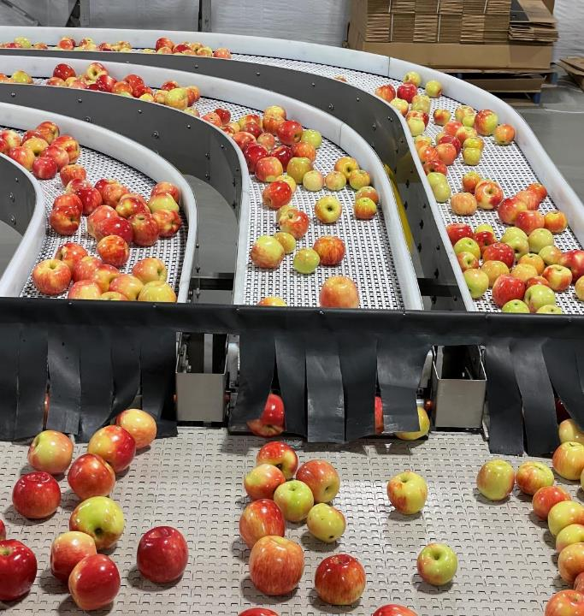
Enabling economic vibrancy
CUSTOMER SUCCESS
Notes:
In some cases, large custom efficiency projects not only bring in a significant amount of cost-effective EE, they can enable economic viability for end-users.
For example: Honeybear Growers in Brewster, Washington upgraded its facility in 2021, installing new automated packing lines, refrigeration controls, and new pumps for washing produce.
Not only did the upgrades reduce the company’s operating costs by saving over 150,000 kWh per year, it also doubled its produce sorting volume.
And the refrigeration controls help them cool apples faster, allowing for longer storage time.
That’s a real boost to their business!
Source: EE project posters from marketing

Slide 15
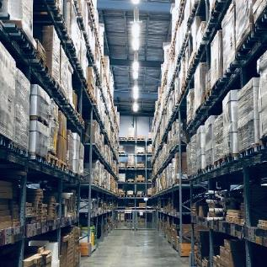


Safety
Impact Beyond Energy Savings
Air quality
Comfort
CUSTOMER SUCCESS
Notes:
In addition, there are many other non-energy benefits of EE.
Increased comfort, noise reduction, and health benefits are all benefits of home weatherization.
As wildfires seem to get worse every year, improving indoor air quality from outside air infiltration is a major health benefit.
Another benefit? Safety! Resistance baseboard and wall heaters are the second leading cause of home fires and eliminating or reducing use of them with a ductless heat pump is a significant safety benefit.* Also, safety measures in non-residential settings like better lighting in warehouses reduce accidents.
In commercial and industrial settings, energy efficient equipment is often higher quality and longer lasting providing economic benefits – beyond bill savings-- that make a difference to the end user’s bottom line.
Sometimes EE can also reduce overall maintenance costs: Variable frequency drives, for example, when added to industrial equipment, typically reduce the frequency of maintenance intervention, which incidentally reduces likelihood of injury.
*SOURCE: Heating Fires in Residential Buildings (2017-2019) (fema.gov)
**SOURCE: Massachusetts Special and Cross-Sector Studies Area, Residential and Low-Income Non-energy benefits (NEI) Evaluation. Tetra Tech and Nexus Market Research. August 2011

Slide 16


Creating Economic Benefits for the Community
Notes:
Let’s talk about the economic benefits of our EE efforts. (2 of 4)

Slide 17


Lower Costs and Lower Bills
“The cumulative efficiency savings since 1980 have reduced consumer electricity bills by about
$4 billion per year.”
– 2021 Power Plan
“
ECONOMIC BENEFITS
Notes:
Historically, BPA has pursued EE because it is the lowest cost resource. Any other resource—whether gas turbines, wind or solar—would have been more costly. That’s why we say that EE is cost effective.
Therefore, BPA’s costs, and therefore rates, would have been higher without our past efficiency efforts.
And of course, end-users don’t pay for energy they don’t use, leading to lower bills.
And the region’s EE programs have reduced bills by quite a lot: As the Council called out in their 2021 Power Plan, “The cumulative efficiency savings since 1980 have reduced consumer electricity bills by about $4 billion per year”

Slide 18
Supporting Regional Capacity Needs
178
MW
=
$1.8M
79 aMW
ECONOMIC BENEFITS
Notes:
Capacity constraints are an emerging issue for many utilities in the region.
BPA’s conservation program will help avoid future capacity constraints and improve our ability to offer capacity products to our customers when they need it.
Let’s look at an example: During the last two years BPA programs achieved 79 aMW of EE.
On a winter morning, those 79 aMW actually provide 178 MW of winter morning capacity
This is because things like HVAC and Weatherization efficiency have a greater impact on load and provide the most value when regional capacity needs are greatest.
If using heavy-load-hour mid-C prices as a proxy, those 178 MW would be valued at $1.8M over the course of a single winter season.
And this value grows over time. Each year, as BPA acquires more efficiency, it adds to the previous acquisitions to provide even more impact when we need it most.**
*SOURCE: “the 2021 IRP analysis finds that the acquisition of new cumulative conservation reduces the scale of capacity needs and defers the PUD’s need for new long-term capacity resources until the mid-2020s”
https://www.snopud.com/wp-content/uploads/2021/12/Final_2021_IRP.pdf
**SOURCE: file:///\\HQ5F01.bud.bpa.gov\ESB\Planning\Bonnie%20Watson\PE%20Value%20Proposition\Task%203.%20Presentation\Pres%20Reference%20Docs\Slide%2025%20capacity%20calculations.xlsx

Slide 19
Deferred Distribution System Costs
ECONOMIC BENEFITS
Notes:
EE can also be a great tool for our customer utilities to push out or reduce capital expenditures on their distribution systems—which lowers their customer’s bills in the long run.
For example, Lower Valley found they had a transformer overheating problem on very cold winter mornings (like below zero). Replacing the transformer with the next larger size could cost more than $1 million, and would occur before the existing transformer was fully depreciated. They found themselves with a couple-hundred-KW-problem and a million-dollar solution. What Lower Valley did was put demand response (DR) controls on most of the water heaters on the feeders served by the existing transformer, producing ~500kW of winter morning peak load reduction. This may not sound like much, but it’s just enough to prevent overheating of the transformer. While Lower Valley chose to use DR as a solution for this problem, utilities facing similar scenarios could deploy EE programs in the same way to reduce load in specific parts of their distribution system. For our smaller customers, small actions can defer significant investments. This type of action can be financially beneficial for our public power utility customers and help keep their retail rates lower than they would be otherwise.

Slide 20


Building a
Resilient Future
Notes:
So… first we covered the Customer Service benefits, and then the Economic benefits of EE. Next, I’d like to highlight resilience. (3 of 4)

Slide 21
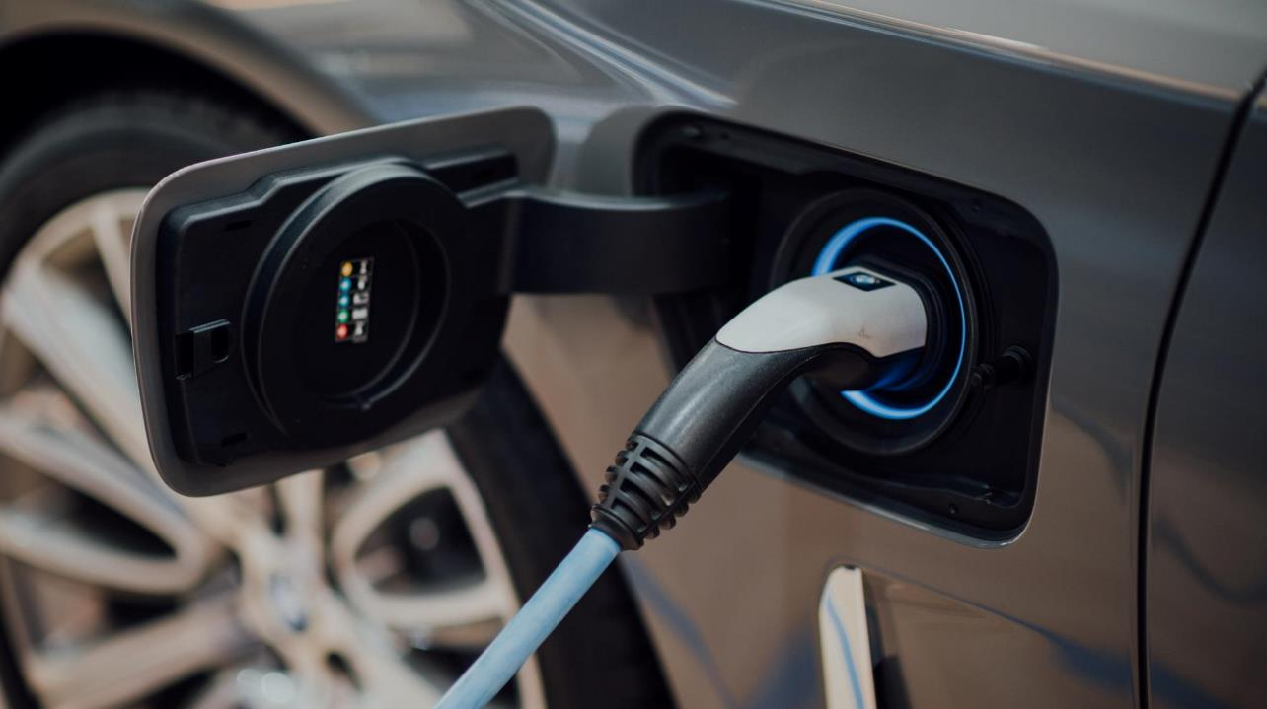
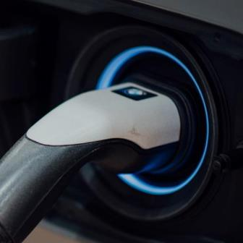


Mitigating the impact of electrification
BUILDING A RESILIENT FUTURE
Notes:
Our historic and ongoing EE achievements have and will continue to mitigate the impact of electrification.
As you know, it is no easy task to provide reliable power while integrating intermittent renewables and accommodating the growing drive for electrification.
Driven by EVs and heat pump adoption, overall load growth will increase and has the potential to become peakier– and more challenging for distribution systems to handle.
Some EE measures like HVAC, lighting and weatherization can take the edge off by reducing peaks. Measures that save energy at the right time of day offer the greatest value.

Slide 22
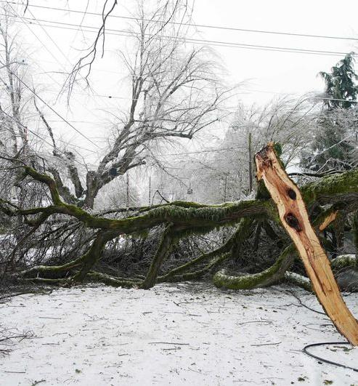
Offering customer resilience in extreme events
BUILDING A RESILIENT FUTURE
Notes:
BPA has invested significantly in weatherization and DHPs. Weatherization in particular is not just an energy efficiency play, or a peak demand reduction play; it can also be a thought of as a resilience program.
Tighter, better insulated homes provide people with enhanced safety and security during extreme weather events, by allowing existing HVAC systems to maintain temperatures better.
In addition to extreme heat waves, we’re also seeing more extreme winter storms. In February of 2021, Oregon experienced an ice storm that left more than half a million homes and businesses experiencing power failures. It was the largest power outage in Oregon’s history.
We can help Northwest people be more resilient to future extreme heat waves or winter storms with energy efficiency.

Slide 23


Minimizing Environmental Impacts
Notes:
Lastly, I want to talk about the environmental benefits of our EE work. (4 of 4)

Slide 24

10 MILLION TONS OF CO₂e AVOIDED
× 100,000
Equivalent to taking more than 2.1 million cars off the road
ENVIRONMENTAL BENEFITS
Notes:
Obviously, there are CO2 reduction benefits to our EE efforts.
Focusing only on replacement resources, we can’t determine the exact amount of resources that would have been built absent our EE investment so therefore it’s impossible to quantify the true total carbon impact of our EE efforts. However, using the Council’s estimate of 0.91 pounds/kWh of CO2 equivalent, BPA’s EE program has reduced CO2 emissions by 10 million tons since 1982. According to the EPA’s calculator, that is equivalent to taking more than 2.1 million cars of the road for a year.
SOURCES:
Council Paper on Avoided Carbon Dioxide Production Rates in the Northwest Power System
The Council’s method determines a WECC-wide marginal emissions rate for 4 different years, 2016, 2021, 2026, 2031. And in each year finds the average emission rates of all hours of the years over 80 different hydro scenarios. https://www.nwcouncil.org/media/filer_public/ac/d9/acd94f75-20ef-4d1c-b0c9-ea5cf113778d/2018-1.pdf
Note: 2357 aMW of savings equating to 8M tons of avoided CO2ew works out to 0.85 lbs../kwh, which is very close to the Council’s 0.91 figure for 2021, which is what Nathan Kelly advocated using for the current rate period.

Slide 25

Avoid environmental impact associated with any new builds
ENVIRONMENTAL BENEFITS
Notes:
At the end of the day, the energy resource BPA has acquired over the years—and will continue to acquire—means power plants did not need to be built.
That’s EE’s impact.

Slide 26
EE as a Resource
Enabling Customer Success
Creating Economic Benefits for the Community
Building a
Resilient Future
Minimizing
Environmental Impacts
Notes:
In summary, while BPA acquires EE primarily as the most cost-effective resource to meet our system needs, there are many other benefits that our customers and Northwest communities reap on top of getting a cost-effective resource.
Any one of these benefits alone may not justify the cost from every perspective, but taken together, our EE work is a slam dunk, and a unifying force in the region for meeting the challenges ahead.

Slide 27






A True Community Resource
$
$
$
$
$
$
$
$
$
ECONOMIC BENEFITS
Notes:
Lastly, its worth considering who reaps the benefits of this resource that we’ve created. EE is truly a community resource in that it is not centralized and owned by one company or corporate entity which captures all the benefits.
By its nature, EE is distributed throughout communities and our customers’ customers. We have work to do to help our customers improve the equitable allocation of EE benefits among end-users, but EE comes a lot closer to that than a merchant-owned gas peaking plant or wind farm.

Slide 28

Thank you for your efforts to bring value to the region and help us accomplish our mission!
BONNEVILLE POWER ADMINISTRATION
Brice Lang
EER | Energy Efficiency, BPA
bnlang@bpa.gov
Notes:
Thank you for your efforts to bring value to the region and help us accomplish our mission!

