Slide 1
Market Research & Momentum Savings Team
Quarterly Call | November 3, 2021
Notes:
Photo by Johannes Plenio – www.unsplash.com

Slide 2
Org Name
+
Favorite candy bar

Slide 3
Weatherization Market Research Findings A look at the total Northwest market beyond programs NOVEMBER 3, 2021
BONNEVILLE POWER ADMINISTRATION
Notes:
Photo by Gustavo Tiffer on Unsplash
Good morning everyone, thanks for joining us for this quarterly presentation. In our presentation today, we’ll be reviewing findings from BPA’s research on the weatherization market. For our purposes today, weatherization refers to adding insulation, sealing air leaks, and upgrading windows in existing homes. This research provides insight both into the overall size of the weatherization market and into common installation practices. As with all of our work, we look at what’s happening in the entire Northwest region, not just BPA service area. And we only looked at electrically heated homes.

Slide 4
Why do we care about Wx?
Customer service
Valuable EE resources
Resilience
Equity
Notes:
Before we dive in, let’s remind ourselves why the region is interested in this market.
Weatherization isn’t just saving energy. Other benefits include:
1) High level of customer service for utility customers. Homeowners often appreciate the support of their electric utility in selecting contractors, ensuring a quality installation, and funding a project with incentives or loans.
2) Weatherization savings occur during winter peak power consumption, and also correlate with lower power production in the Columbia River Hydro System. These are very valuable savings to the region.
3) Weatherization improves homeowner resilience in adverse conditions, such as times when extreme weather prevent heating or cooling equipment to operate. A more efficient building shell keeps temperatures reasonable for longer and reduces the demand on backup heating resources.
4) Weatherization is part of a broader strategy for equity in EE program spending. These measures can be made accessible and valuable to hard-to-reach markets, but weatherization can impact nearly anyone.
In addition to these reasons, building shell has such an important and large impact on HVAC energy consumption. In order for us to accurately model the total market energy consumption for residential HVAC, we need to account for weatherization. The BPA research team is also interested in Wx because we know that BPA is investing a lot in ramping up the Comfort Ready Homes program, and this research can help to inform strategy and targeting that program. Which leads me to my next point on why we did research on this market…

Slide 5
Why characterize the Wx market?
Supplement stock assessments
Help programs be most effective
Input to Residential HVAC Market Model
Notes:
I just talked about how Wx is part of our res HVAC market modeling work, but an important reason we decided to do more research on Wx is because this market is pretty under-characterized.
Weatherization has been a workhorse of utility energy efficiency programs for decades, but little is known about the market at the regional level because it’s difficult to study. We've got the stock assessments to tell us the region's home shell quality at one point in time, but it’s difficult to compare between the RBSAs to establish how shell quality has changed over time. So we want to supplement the RBSAs with other research to gain a good picture of the Wx market.
We think this research can help utilities with their understanding of the market, installation practices, and the influence of programs. For example, BPA’s market research team is working with BPA’s Comfort Ready Homes program to use these findings to help target the CRH program to where it will have the least cost for the most gain. This will help programs use resources most effectively. This conversation is ongoing.
Finally, of course, weatherization is an important input in the Residential HVAC Market Model. The inputs to the model are draft, but we have learned a lot about this market and wanted to share our early findings.
Note BPA’s Comfort Ready Homes program conducted a weatherization and contractor infrastructure assessment in 2020 to better target services to areas with the greatest potential for specific weatherization opportunities. https://www.bpa.gov/EE/Sectors/Residential/Documents/CRH/Weatherization_Contractor_Infrastructure_Assessment.pdf https://comfortreadyhome.com/
Now that we’ve covered “the why”, let’s get into “the how”…

Slide 6
Overview of Research
Notes:
I’m going to briefly talk about what research we did and the data sources we used to come up with the findings, which I’ll share with you in the next section.

Slide 7
Data Sources
RBSAs – Audited stock data
Principia – Single family insulation sales data
Combined data sources to build the most robust quantitative estimate of weatherization activity in 2016-2021
RCP – Reported Wx program savings
Notes:
No single data source provides a total picture of the weatherization market.
In addition to the RBSAs mentioned earlier, we decided to purchase insulation sales data from Principia, a market research firm that provides data for the construction industry. Principia uses extensive quantitative research to estimate insulation sales volume over time, in the form of pounds of insulation. They validate the estimates through in-depth interviews with insulation market actors. We believe this source provides the best available data on single family insulation activity in the region.
https://www.principiaconsulting.com/u-s-residential-insulation-market-demand-at-a-glance/
Last but not least, we have a robust data source on the program-driven portion of the market, which of course, is the Regional Conservation Progress report. It provides Weatherization savings reported by regional utilities every year. We also have more detailed BPA program data from the BOOM report. https://rtf.nwcouncil.org/about-rtf/conservation-achievements/2020
Each of these three sources cover a subset of the Weatherization market in the region. Our analysis puts these three data sources together to estimate total regional building shell upgrades in existing homes during the Seventh Plan action plan period (2016-2021). Looking at this 6 year time period helps us assess market trends over time and could help inform some forward looking forecasting.
These are the big three “hard datasets” that we used, but we also supplemented this information with…
More information in RBSAs:
The RBSAs, which are completed by NEEA every 5 years, provide point-in-time estimates of shell quality for all homes in the region. However, as we mentioned earlier, shell quality results from these studies, especially around insulation, are difficult to measure and are subject to auditor variability. And we’ve learned that comparing between the RBSA I and RBSA II on the topic of shell quality is challenging.
https://neea.org/data/residential-building-stock-assessment

Slide 8
Plus… a big installer survey
61 insulation installers in all 4 Northwest states
Represents over 16,000 jobs performed in 2019
Regionally representative findings on common installation practices and market conditions
Notes:
A big primary data collection in the form of installer surveys, to gain more updated understanding of typical installation practices for attic, floor, and wall insulation projects.
We put together a large population frame and robust sampling plan, and completed over 60 surveys from installers across the region, including solid representation from Idaho (16%) and Montana (13%).
We collected regionally representative information common practices in insulation projects, and later on we’ll share the most interesting findings from the survey.
More notes about information collected: number of jobs and average square footage per job by application, standard approaches to estimating R-value, insulation removal, and target R-values. Estimates on the portion of work occurring in efficiency programs and the portion associated with major renovations.

Slide 9
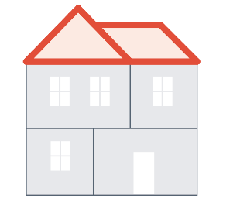
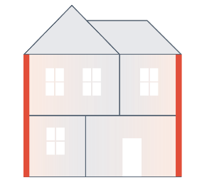
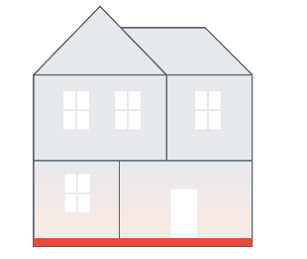
A note on data
Unit = Normalized Number of Homes Fully Weatherized
Captures shell improvement from a baseline home to a fully upgraded home
Notes:
Before we get into the findings, just a quick note on how we’re going to show the findings in the simplest, clearest way possible.
As you know, tracking weatherization activity is different from, and in some ways more complex than, modeling the market of HVAC equipment. For weatherization, we have several measures (insulation, windows, air sealing) that contribute energy savings in the same end use, which is HVAC equipment savings.
And because we’re combining data from different sources, some of which are not direct energy savings, we can’t show you Wx activity in terms of aMW energy savings. Instead, we normalized all data to number of Homes Fully Weatherized.
One normalized home weatherized essentially captures the amount of shell improvement needed to go from a baseline home (as of 2015) to a home fully upgraded with all Wx measures, including insulation, windows and air sealing. That estimate comes from modeling homes in the RTF’s SEEM energy modeling tool.
And we’ll quantify the total amount of Wx happening in the market over time by the number of Homes Fully Weatherized. This is just another way of showing Wx activity without directly showing energy savings.
If asked: this unit is not the same as the unit used in BPA’s low-income program’s number of weatherized homes. This unit combines the UA improvement from all Wx projects done in the entire market, and normalizes to the unit of one fully weatherized home.

Slide 10
Weatherization Market Findings
Notes:
Let’s dive into findings! We’ll start by giving a picture of the Wx market as a whole, inclusive of insulation, air sealing, and windows, and spanning across all existing home segments (SF, MH, MF).
Then, we’ll zoom in on the biggest portion of the market, which is insulation in existing single family homes. And I'll also quickly touch on windows and air sealing.
One last note: the findings I’m going to show you are going through our external review process in the coming weeks. We don’t anticipate major changes to the results from the review process, but all data should be considered draft for now.

Slide 11
Wx activity is steady
Total Wx market activity upgrades a significant portion of the region each year
DRAFT
Notes:
First finding, overall at the regional level, total Weatherization activity is relatively steady over the years, with maybe a slight decreasing trend.
This chart is showing the Wx activity in terms of normalized number of homes fully weatherized in each year from 2016 to 2020. This includes shell upgrades from insulation, windows, and air sealing in all electrically heated residential building types.

Slide 12
What impact does that activity have in the region?
Market activity upgraded the equivalent of ~110,000 “fully weatherized” homes between 2016-2020
=
110k homes
Notes:
That steady market activity is equivalent to about 110,000 fully weatherized homes between 2016 and 2020. We don’t know how many actual homes that were upgraded by a contractor in the region, but we do know the total amount and it represents a significant amount of insulation, windows, and air sealing happening in homes throughout the region.

Slide 13
40% of Wx jobs participate in EE programs
Programs’ share of Wx activity has decreased over time.
DRAFT
Notes:
What's programs' portion of this market? We estimate that regional programs fund about 40% of Wx jobs in the region in 2020, the latest year that data is available. This is a decrease from what was happening back in 2016, when programs captured more of the total market. While this does mean we as a utility community only pay for 40% of the savings, getting more people involved in utility programs represents an opportunity to ensure deeper, more thorough weatherization jobs, and form a relationship with utilities that can be leveraged for other programs.
Chart Sources
Non-Program Retrofits: Cadeo analysis of RBSA I, RBSA II, and Principia market data
Program Retrofits: Northwest Power and Conservation Council Regional Conservation Progress Report, 2020

Slide 14
Single Family Insulation
Notes:
Let’s zoom into single family insulation market, which represents the biggest source of Wx activity (32% in 2016 and 42% in 2021) and was the primary focus of our research.

Slide 15
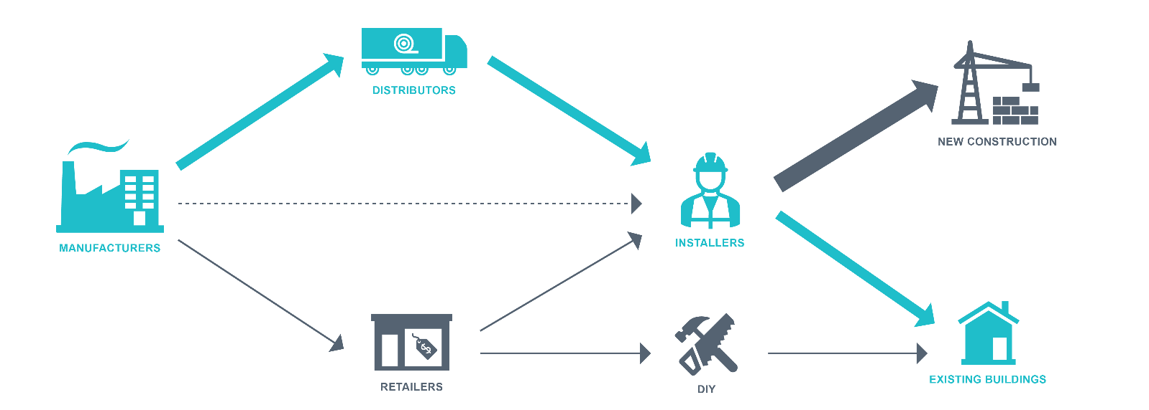
Insulation supply chain
For retrofits, insulation primarily travels to market through distributors and professional installers.
Equipment
Weatherization
Notes:
Just a quick overview of the insulation supply chain. Our research focuses on the most common path for existing weatherization retrofits, which is for insulation materials to travel through distributors and installed by professional installers in existing homes. Our research does indicate that new construction is a larger piece of the insulation market than retrofits in the Northwest, but that was not the focus of our research.
Source: BPA Insulation Installer Survey, 2020

Slide 16
SF insulation market is steady, program portion declining
Insulation activity in existing SF homes is increasing slightly over time, even though fewer projects participate in programs.
DRAFT
Notes:
Overall, insulation in existing single family homes is increasing slightly over time.
Program activity represented about 30% of total market in 2020/2021. This number matches what we learned from the insulation installer survey as well, where installers reported approximately a third of insulation projects participate in utility programs.
We also see here that fewer insulation projects are going through programs over time, which is similar to what we saw in the total Wx market.
There are many reasons that projects might not participate in programs. Reasons include:
No program available
Project doesn’t meet program specifications (such as maximum starting R-Value)
Project participates in a low-income program or other programs that are not funded by utilities
Installer or home owner preference
Chart Sources
Program Retrofits: Northwest Power and Conservation Council Regional Conservation Progress Report, 2020
Non-Program Retrofits: Cadeo analysis of RBSA I, RBSA II, and Principia market data

Slide 17
Installation practices between program vs. non-program jobs
Program-quality jobs may have higher impact in terms of:
Air sealing and ventilation
Duct sealing requirements
Specific qualifying R-values
1/2
of installers said they use same installation practices for non-program work
Notes:
We’ve shown you the hard data about what's going on with the insulation market. Let’s look at some other insights we learned about the market directly from installers.
Half of contractors use identical installation practices in non-program and program jobs. Programs adopt specifications to ensure that weatherization projects deliver the promised energy savings, are more durable, and capture all opportunities for improving occupant comfort such as measures that might be covered by insulation.
Within the group that reported differences between program and non-program work, installers described the main difference being that programs typically have more requirements on venting or air sealing, and they also require the existing R-value to be below a certain threshold to qualify for incentives.
To us, the key takeaway from this finding is that non-program jobs may not be that different from program jobs when it comes to the insulation job itself. But rather, program jobs are promoting other related measures such as air sealing the component first. More stringent requirements for the starting condition target homes that likely need Wx upgrades the most for program incentives, but the homeowner will still find value in upgrading a moderately insulated house. All of this aligns with what BPA’s Comfort Ready Homes is trying to promote.
And lastly, we believe that programs over the years, along with codes, have had a significant impact on the quality of weatherization projects completed in the market overall, inclusive of non-program projects….
This leads to the next slide about common installation practices!
Source: BPA Insulation Installer Survey, 2020

Slide 18
Attic insulation R-values improve
R - 49
Typical target for attic insulation
13in
R-38
16in
R-49
80% of attic insulation is installed to R-49, a significant improvement in standard practice.
Notes:
According to the installers surveyed, over 80% of attic insulation is installed to a depth of R-49. This finding may illustrate the influence of codes and programs on installer standard practices in the market. Just a few years ago, R-38 was a standard practice depth for attic insulation.
Source: BPA Insulation Installer Survey, 2020

Slide 19
Spillover effect from retrofits
Many non-program retrofits are associated with a remodel, but insulation often extends beyond permit requirements.
60%
of installers said it’s “common” to install insulation beyond permitted area
Notes:
Installers reported that the insulation market is roughly split between retrofit projects that participate in programs, projects that are associated with a renovation, and non-program retrofits.
For the insulation projects that are associated with a larger renovation that received a building permit, the insulation is required to be increased to current building code. Interestingly, 60% of the installers we surveyed also reported that it was “common” or “somewhat common” to insulate beyond the area covered by the permit. In other words, the homeowner or general contractor who hired the insulation contractor decided to simply insulate the entire area since the contractor was already making the trip.
Lastly before me move onto windows and air sealing:
One thing our market modeling team was interested in was how much insulation was being installed due to meeting code requirements as part of renovations in existing homes. We asked this question but note that there remains uncertainty around these findings because we asked the question to and insulation contractor, but a renovation permit is typically the responsibility of a different contractor or a homeowner. The installation contractor may not have clear insight into what that responsible party was doing.
Source: Insulation Installer Survey, 2020

Slide 20
Windows and Air Sealing
Notes:
Our weatherization market research primarily focused on insulation, but we did include windows and air sealing in our analysis, primarily summarizing what we could tell from RBSA comparison and program data.

Slide 21
Efficient windows trending downward
RBSA data indicates 3/4 of SF homes have efficient windows in 2016, indicating a smaller remaining potential
DRAFT
Notes:
Our analysis sees the market for efficient windows decreasing slightly over time. In this case, the term “efficient” refers double or triple pane with a non-metal frame, aligning with program rules for qualifying for incentives.
This makes sense as the 2016 RBSA survey informs us that only 25% of existing SF homes still have potential for window upgrades.
Compared to insulation where our primary data source was the Principia data, we used the two RBSAs to analyze the window improvements that occurred over time (and applied that trend to 2016-2020. The research team believes that these data from the RBSAs are less subject to auditor uncertainty than insulation because the inputs are more objective, (for example, single pane versus double or the framing material).
Chart Sources
Program Retrofits: Northwest Power and Conservation Council Regional Conservation Progress Report, 2020
Non-Program Retrofits: Cadeo analysis of RBSA I and RBSA II

Slide 22
Air sealing occurs outside of programs
Air leakage reductions are common and easy to do.
DRAFT
Notes:
Most reductions in air leakage happens outside of programs. Air sealing is easy to do but hard to quantify to claim program incentives. Programs often require blower door tests performed by a trained and certified contractor to participate in an air sealing program.
For the market model, we considered air sealing as the change in average building shell air leakage, not with a measure of contractor activity. This definition is somewhat broader than what many programs might consider as “air sealing”. For example, homeowners and renters alike will caulk around windows, seal pluming penetrations, or add door weatherstripping. Additionally, weatherization contractors can easily perform air sealing services as an incidental part of an insulation project, like spraying some foam around plumbing penetrations during the prep phase before insulating. Finally, home improvement projects can reduce air leakage as an inadvertent benefit of the project, including upgrading windows, adding dense-packed wall insulation, or remodeling a room.
We may see some influence of a programs and trainings in these leakage reduction estimates. Many utility programs emphasize air sealing building envelope penetrations prior to adding insulation in an attic or a floor, which would hide but not necessarily seal those leakage locations. These leakage reductions are real even if they don’t get an incentive, and the activity might become standard practice for contractors that adopt it.
As with windows, we relied on trends indicated by the RBSA surveys for changes in air sealing. We believe air leakage data can be reliably compared between the two RBSAs because blower door measurements are more objective the measurements of insulation R-value.
Chart Sources
Program Retrofits: Northwest Power and Conservation Council Regional Conservation Progress Report, 2020
Non-Program Retrofits: Cadeo analysis of RBSA I and RBSA II

Slide 23
Air sealing practices
Most contractors are capable of offering air sealing services, but may need help selling customers on benefits or participating in programs.
80%
of insulation contractors offer air sealing services
15%
of projects use diagnostic equipment
Notes:
Over 80% of contractors regularly offer air sealing services, either prescriptive or associated with a performance leakage test. However, only 15% of projects use diagnostic equipment like blower doors, duct leakage testing equipment, or infrared cameras. This finding reinforces the previous slide that air sealing is common but not frequently reported to programs.
Source: BPA Insulation Installer Survey, 2020

Slide 24
Wrap Up

Slide 25
Key Takeaways
Wx market is steadily improving shell quality of homes in the region.
Common installation practices are aligning with code and programs.
There’s more to be done!
Research will help BPA target the Comfort Ready Home program’s strategy to grow the weatherization market
Notes:
Taken cumulatively, the weatherization market has done the equivalent of improving 127,000 homes of existing building stock from the market average home to a fully weatherized home during the 7th plan action period. The rate of activity is roughly steady through time with maybe a slight decreasing trend, although programs have decreased more quickly. In the installer survey, we see some evidence that programs and code have affected installer’s standard practices, and that impact is likely resulting in higher-quality weatherization projects and increased energy savings. Finally, this research is helping BPA implement the Comfort Ready Home program and target their activities with contractors in the region.

Slide 26
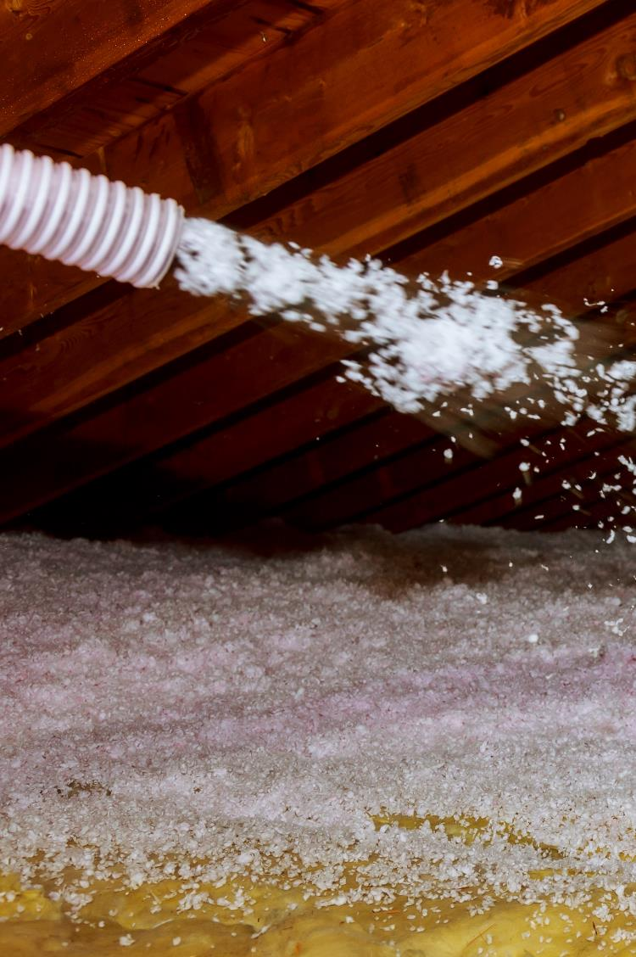
Discussion
Notes:
Prompts:
Did you find anything surprising? I was interested that standard attic insulation practice has increased so dramatically and that so many insulation contractors offer air sealing services as well.
What do you think this means for your work?
Opportunities to push the market to more homes getting weatherized?
What other info would be helpful to programs?

Slide 27
Contact Joan Wang, Res HVAC Project Lead jjwang@bpa.gov
Notes:
That concludes our findings from these market actor interviews. I want to pause here for any questions.
These interviews provide some great insight into a very complex market, helping BPA’s market research team refine their approach to modeling energy consumption and helping BPA program to find different levers or ways to further grow the Wx market.
Please reach out to Joan and the Market Research Team if you have any questions on this presentation or Wx in general.

