Slide 1


Market Research & Momentum Savings Team
B O N N E V I L L E P O W E R A D M I N I S T R A T I O N
Quarterly Call | May 5, 2021
Notes:
Photo by Katie Moum on Unsplash.com

Slide 2

Org Name
+
Favorite Summer Fruit
Notes:
Welcome to the second Momentum savings quarterly call of 2021!
Roll call and ice-breaker.

Slide 3
Agenda
Refresher: Momentum Benefits (20 min)
Supporting Diversity, Equity, & Inclusion (5 min)
Communications Survey Results (10 min)
Summer Learning Series (5 min)

Slide 4

REFRESHER BENEFITS OF MOMENTUM SAVINGS
RESEARCH

Slide 5

WHAT MOMENTUM SAVINGS ARE

Slide 6
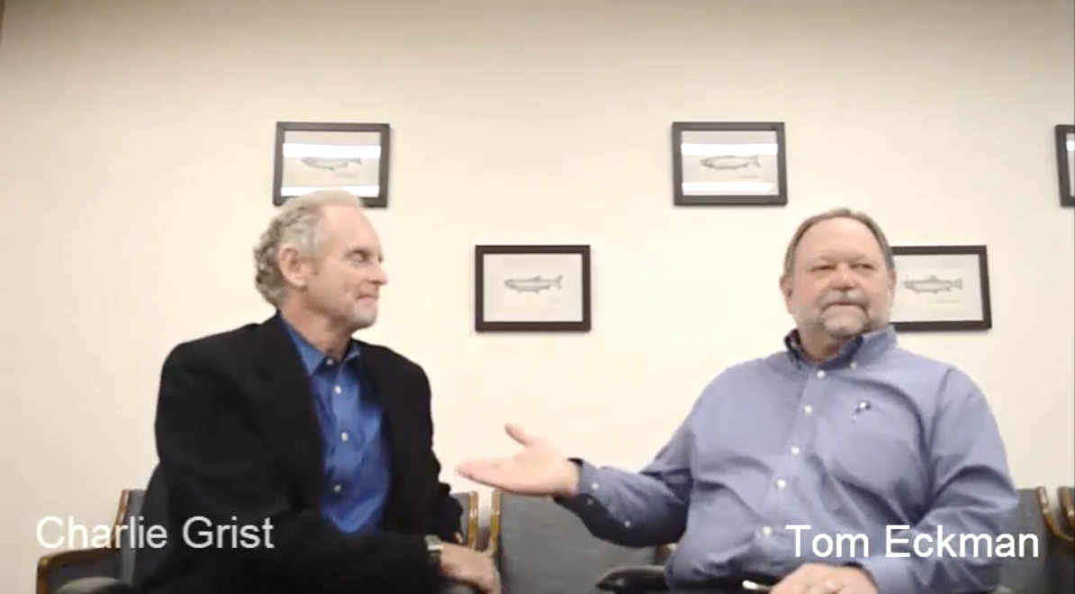
WHAT MOMENTUM SAVINGS ARE
Momentum Savings are cost-effective energy efficiency happening above regional planning baselines (i.e., the Power Plan baseline).
“Non-Programmatic Savings are everything we haven’t counted that’s worth counting.”
Tom Eckman, NWPCC
Notes:
Over the past several decades, a range of mechanisms have contributed to a robust infrastructure for energy efficiency in the Northwest. The region as a whole has done a lot of work to create and push energy efficiency, which has helped create a culture and a market for energy efficiency, and changed how the culture values conservation (adapted from Cadmus, 2011; Navigant, 2016).
While programs have been a significant driver—and will continue to be critical in driving markets towards greater energy efficiency—there is an interconnected web of actions—inextricably linked—that have contributed to the overall energy efficiency of the region. Other market-induced drivers of energy efficiency include technology trends, corporate sustainability policies, and shifts in social norms (e.g. the “green movement”) (Navigant 2016; Cadmus, 2011)
Regardless of the reason, if energy efficiency is happening to a greater extent than planned, and electric consumption is decreasing/lower than planned, this conservation represents generation not needed. (Summarized, in part, from Tom and Charlie video—link below)

Slide 7
In addition…
Momentum Savings are:
In the
Savings
Potential
Strategically Focused on Important Markets
Rigorous & Defensible

Slide 8
BENEFITS OF MOMENTUM SAVINGS RESEARCH

Slide 9
Benefit #1: Responsible Stewards of Ratepayer Funds
Notes:
The process of researching and quantifying the Momentum Savings enables BPA to act as a responsible steward of ratepayer funds because the research helps direct financial resources to their most cost-effective use.
BPA’s research illuminates where savings are happening without utility funding, and quantifies that resource, so that BPA and others can better target investments.
By quantifying the total efficiency in the market and understanding where it is occurring, BPA can direct its budget to achieve the greatest impact. That may mean investing in harder-to-achieve measures, measures with greater demand/capacity value, or areas of inequity.

Slide 10
Benefit #1 in Action: Residential Lighting
General Service Lamps
Notes:
We all saw in our 2010-2015 residential lighting model that the majority of lamps being sold in the region were without incentive. As the chart shows, you can see that LEDs and halogens went from non-factors in 2011 to two of the three dominant technologies in 2015, while incandescent market share plummeted from 68% to 12% over the same timeframe. We also saw LEDs eating into CFLs market shares.
This information from the momentum savings model gave the region a clear indication that programs and federal standards were successful in transforming this market to being much more efficient, and it was time to ramp down out of the general purpose residential lighting market.
Over the past several years BPA has dropped incentives for res lighting. Other utilities in the region have also ramped down their incentives. This frees up important program resources to focus on other markets that need help from programs.

Slide 11
Benefit #2: Measures the Total EE Resource
Notes:
Just like regional power planners think of EE program savings as a power resource, efficiency that is happening above the Council baseline that is not funded with a rebate or some other utility-funded mechanism—whether the cause is a new federal standard, market change, or anything else—is another type of efficiency resource.
BPA calls this efficiency Momentum Savings, but regardless of its name, it has the same impact on the region’s resource needs as efficiency acquired through direct utility payment.
This fundamental truth is essential to why BPA researches and quantifies Momentum Savings: the need for new generation to be built can be avoided when consumption is lowered, whether because of Momentum Savings or utility-funded energy savings.
BPA seeks to count the total efficiency resource.

Slide 12
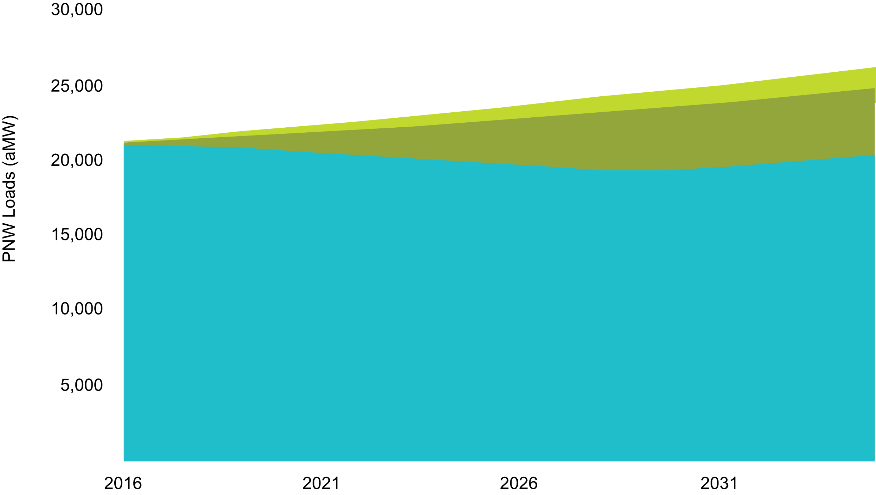
Benefit #2 in Action: Standards
Savings from Federal Standards
Energy Efficiency
Net Load After Energy Efficiency
Notes:
During the Obama administration we modeled the Momentum Savings for the PNW of 45 federal and state appliance efficiency standards.
The savings impacts of appliance standards since the last 6th Plan was developed are as large as building a new dam over the next 20 years—1,500 aMW for the region over the next 20 years.
This is enough to power over 1 million homes.
This is amazing, and a success story for energy efficiency—it is the only power source that is widely generated to this large of a scale by end-users without using utility funds.
Source: https://www.bpa.gov/EE/Utility/Momentum-Savings/Pages/Appliance-Standards.aspx

Slide 13


Benefit #2 in Action:
Efficient General Purpose Lamps
95 Million
Program Lamps
400 Million
Momentum Lamps
Each bulb represents 5 million lamps
Notes:
Looking at this another way: Residential lighting programs incented just over 95 million efficient lamps between 2010-2015
Our modeling work estimated that there were an additional 400 million efficient lamps installed outside of programs that were creating real savings but we wouldn’t have been able to account for it if it weren’t for our research.
Without this research, this is a blind spot.
SOURCE:
Total residential lighting efficient lamp sales: 502,463,314 lamps sold 2010-15, [Table 11, 2010-2015 Residential Lighting Model Results]
Program lamp sales: [Table 14, 2010-2015 Residential Lighting Model Results]
95,440,472
Momentum lamp sales: 407,022,842.
The 2010-2015 Res Model Results are hyperlinked above and here on the Momentum Page:
https://www.bpa.gov/EE/Utility/Momentum-Savings/Documents/2010-2015_Model_Results.xlsx

Slide 14
Benefit #3: Market Intelligence for Programs
Notes:
Our Momentum Savings research helps to identify strategic opportunities that help programs increase the efficiency of the market. This happens by:
Helping our program dollars go further by identifying segments of the market that programs aren’t currently influencing
Confirming where inefficient products are still being sold that need program intervention to become more efficient
Creating awareness in shifts in market dynamics

Slide 15

Benefit #3 in Action: Insulation Research
Notes:
Right now we are analyzing quantitative data from a regionally representative survey we did with insulation installers and looking at the total volume of insulation being sold into the region.
This project seeks to understand how much insulation is being added to homes outside of utility programs.
This information will help programs to understand what types of homes are NOT adding insulation so that they can focus their program efforts on those buildings.
We are collaborating with the BPA program staff on the Comfort Ready Home program to make sure they have this valuable market intel as they ramp up program implementation.

Slide 16

Benefit #3 in Action: Commercial HVAC Permit Database
Notes:
Another example is the data we are collecting right now on new construction and major renovations in commercial buildings.
We’re building a new data resource using publicly available com building permit info to learn about what kinds of com HVAC are installed in new buildings and big renovations.
Not only will this new data resource be a key input into our future market model, it will help shed light on a previously not well researched area of the market that doesn’t have a lot existing and readily available data.
Shining a light on this unknown part of the market that is such a big area of energy consumption and high priority initiative for programs will help identify opportunities, emerging trends in technologies, or target markets for programs.

Slide 17
Benefit #4: Data Support for Regional Planners
Notes:
BPA’s research is accessible to all stakeholders and supports critical regional measure development and planning functions.
Our work generates region-specific market intelligence that folks can use for their own purposes, including establishing more accurate potential assessments and measure baselines, understanding market trends, and understanding the impact of new technologies.

Slide 18
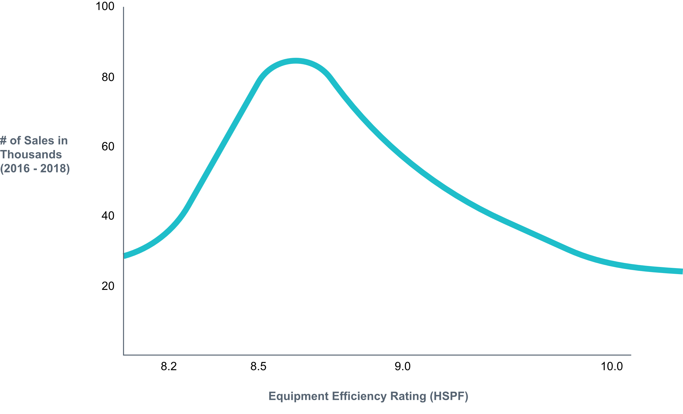
Benefit #4 in Action:
RTF Baseline Data
CURRENT PRACTICE
Notes:
For example, the Council uses data collected through BPA’s research to aid in the development of future Power Plans, as do other regional entities and their contractors.
Similarly, the Regional Technical Forum has relied on BPA’s sales data collection and analysis to set and update current practice baselines for various measures, including the non-residential lamps as well as for residential air source heat pumps, shown in the chart here.
In turn, the region benefits from more accurate savings estimates and targets. Perhaps more important, BPA’s goal in promoting and sharing its research and data is to enable like-minded organizations to achieve their greatest impact given their resources.
Source: Current practice ASHP HSPF from Table 11: 2016-2021 Model Results

Slide 19
Summary: Key Takeaways
Momentum Savings research…
Helps us be more responsible stewards of ratepayer funds
Provides a complete picture of the total EE power resource
Offers valuable market intelligence for programs
Delivers critical data support for regional planners

Slide 20

Additional Resources
Explainer videos:
https://www.bpa.gov/EE/Utility/Momentum-Savings/Pages/
Videos.aspx

Slide 21
PART 2:
PRINCIPLES OF RESEARCHING MOMENTUM SAVINGS
Mark Your Calendars:
August 4, 2021, 9-10am

Slide 22
Diversity, Equity & Inclusion
We want input on what data is needed.
Please email us if you have ideas or suggestions: momentumsavings@bpa.gov
Notes:
Important issue, need for data (exactly what data is still TBD)
Our team is beginning to explore if and how our research could potentially expand to capture some of the data that would help programs, planners, and policy makers get a better handle on how we can improve DEI.
Early in this exploration, reviewing the SIF materials and will probably talk to some experts. Will continue to think about this for the remainder of the year and especially important as we move into 2021 Power Plan.

Slide 23
MOMENTUM COMMUNICATIONS SURVEY RESULTS

Slide 24
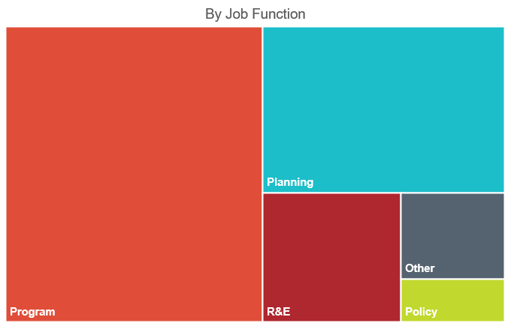
Summary of Respondents
Notes:
There were 33 survey respondents. Most respondents self-identified as working in Programs or Planning functions.

Slide 25
What types of information do you find most valuable?
Notes:
Market intelligence, energy consumption trends, and research project results were ranked the most valuable types of information.

Slide 26

Which work products are most valuable to you?
Most Value Least Value
Notes:
Market characterization reports, and sales and shipment data summaries were ranked most valuable.

Slide 27
What are the best ways for us to share new information with you?
Least Preferred
Notes:
Quarterly calls were identified as the outreach method most preferred by respondents.

Slide 28

E-mail/Newsletter with links
More frequent outreach
Record calls
More targeted information by utility
Comparison of results and trends to other regions
How Momentum is different from market transformation
Website updates
We heard you. Thank you for your feedback and recommendations.

Slide 29

MOMENTUM SUMMER LEARNING SERIES
LINK: Momentum Savings Calls (bpa.gov)
Notes:
Click the hyperlink for more details on the BPA website.

Slide 30


Summer Learning Series Dates & Topics:
6/2, 9-10 AM – HVAC Market Actor Interviews
6/24, 9-10 AM – ASD Market Actor Interviews
8/4, 9-10 AM – Quarterly Call
9/8, 9-10 AM – Non-Res Lighting Sales Data
https://www.bpa.gov/EE/Utility/Momentum-Savings/Pages/Calls.aspx
MomentumSavings@bpa.gov
Notes:
Photo by Ethan Robertson from Unsplash.com

